Slide 1
Corporate Club Officer Training
District 91 – UK South
July 2015
Vanessa King
vanessa.toastmaster@gmail.com
Dorothea Stuart
dorotheastuart@blueyonder.co.uk

Slide 2
Agenda
Time | Item
19:00 | Arrive
19:15 | Welcome and Introductions Vanessa King
19:25 | Making the Most of Moments of Truth Samir Malak
20:10 | Break
20:20 | Top 10 Tips for Corporate Clubs Vanessa King
20:35 | Role Breakouts Dorothea Stuart
21:15 | Q&A & Wrap Up All
21:30 | Finish

Slide 3
Business Benefits of Corporate Clubs
Employee goal achievement
Improved performance
Increased productivity
More productive teams
Effective meetings
Better leaders
Better employee communication
Better customer communication
Improved morale & retention
Strong return on people development investment

Slide 4
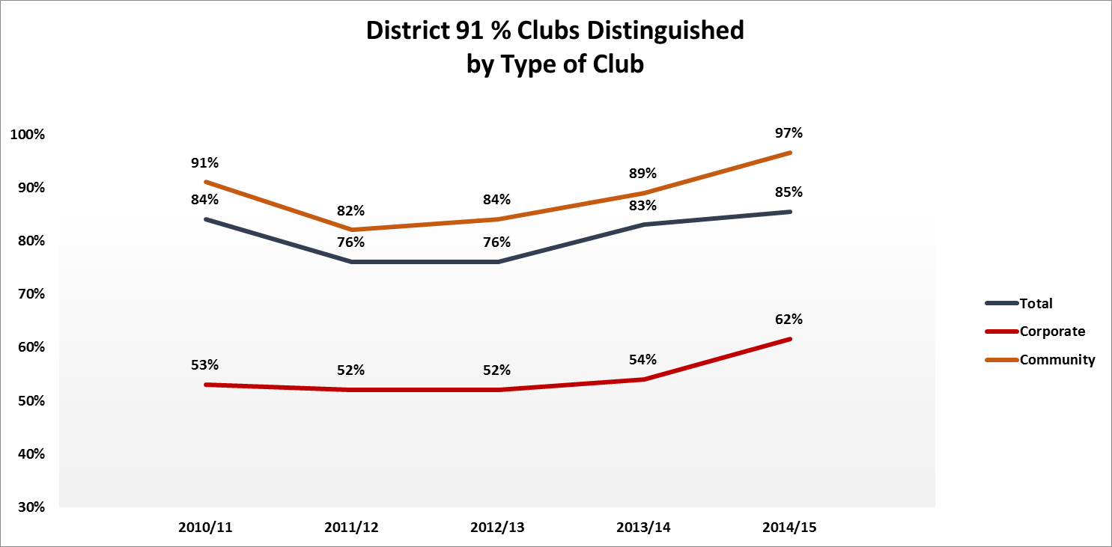
Distinguished Club History in UK South

Slide 5
100% Distinguished
Connected Speakers London
FM Global Communicators
ACCA Members Breakfast Club
County Communicators *
Cass Toastmasters *
NZICA Bank Speakers
WIBF Speakers-City Club *
MLP London Bridge Speakers *
Citi Criers Club
London Business School Public Speaking Club
Distinguished Every Year for the Last 4 Years, or since Chartering
* Presidents Distinguished in 2014/15

Slide 6
Making the Most of Moments of Truth
Corporate Club Officer Training
Samir Malak samir.malak@gmail.com

Slide 7
Agenda
What is Moments of Truth?
Why Moments of Truth?
How? Moments of Truth in Action ^{(activity)}
When? Moments of Truth in Practice
Conclusion & Commitment
Warm up! ☺

Slide 8
Warm Up! Your Moment!
Start with the “Why?”
Why are you here? Why are you at COT? Club Mission:
We provide a supportive and positive learning experience in which members are empowered to develop communication and leadership skills, resulting in greater self-confidence and personal growth.
WARM UP: What is your moment?

Slide 9
What is Moments of Truth?
A Moment of Truth is . . .
Contact point with prospects / members
The Successful Club Series
Projects that Focus on Club Quality
1st Project in the Series is MOT
Counts towards Advanced Leader Bronze
Club Evaluation by Members
6 critical moments

Slide 10
What is Moments of Truth?
The 6 key Moments of Truth the Club Evaluates
First Impressions | Program Planning & Meeting Organization
Membership Orientation | Membership Strength
Fellowship, Variety, & Communication | Achievement Recognition

Slide 11
Why Moments of Truth?
Toastmasters International Mission:
We empower individuals to become more effective communicators and leaders
Club Mission:
We provide a supportive and positive learning experience in which members are empowered to develop communication and leadership skills, resulting in greater self-confidence and personal growth.

Slide 12
Why? Membership Lifecycle
New Member
Guest
Established Member
Prospect
Ex-Member

Slide 13
Why? Club Success Plan / Area Director Visits
Prospect / Guest
New Member
Established
Member

Slide 14
Why? To better serve members!
Area Director Visit Reports
Membership Lifecycle
Moments of Truth
Club Success Plan (DCP)
All connected . . . to the success of our members!

Slide 15
How? Moments of Truth in Action
How does it work?
Activity 1
How did it work?
How do we streamline . . .

Slide 16
How? Moments of Truth in Action
How did it work?
Challenges?
Time
What are we doing?
Handout
How to streamline . . .

Slide 17
How? Moments of Truth in Action
Teamwork / Preparation
Streamline!
Assign each topic to an officer
Custom Handout
Assign scribe to capture feedback!
Facilitator to Review the Plan
Involve all officers
Preparation is Key

Slide 18
When? Moments of Truth in Practice
Recommended 1/year
Best practice: as part of club officer elections/handover in preparation of Club Success Plan and readiness for Area Director Visits
Teamwork – involve all officers!
Preparation is Key
Who succeeds? Club, Officers, Members!
May | June | July | Aug | Sept | Oct
Club Officer Elections
 | Club Officer Handover
 | Club Officer Training
 |  |  | Area Director Visits
Moments of Truth

Slide 19
Conclusion & Commitment!
Do you see the value?
Will you commit?

Slide 20
Moments of Truth
Vanessa King, LGM

Slide 21
The Journey of Truth
Curious?
Guest
New Member
Established Member
Ex Member
FIRST IMPRESSIONS - MEMBER ORIENTATION - HOW THINGS WORK

Slide 22
Moments of Truth – Curious?
Curious?
“It’s in a great location”
“The website and marketing materials show it’s the right place to be”
FIRST IMPRESSIONS - MEMBER ORIENTATION - HOW THINGS WORK

Slide 23
Moments of Truth - Guest
Guest
“I’m welcome”
“They asked me to join”
“They will take care of me”
“This place is brilliant!”
FIRST IMPRESSIONS - MEMBER ORIENTATION - HOW THINGS WORK

Slide 24
Moments of Truth - Newbie
New Member
“I am welcome”
“I know how to get started”
“I know how things work”
“I know who is who”
“This place is brilliant!”
FIRST IMPRESSIONS - MEMBER ORIENTATION - HOW THINGS WORK

Slide 25
Moments of Truth - Member
Established Member
HOW THINGS WORK
Fellowship / Variety / Communication
“I like it here”
“I belong here”
Programme Planning & Meeting Organisation
“We know what we are doing”
“It is worth my while being here”
Membership Strength
“There are enough of us”
Achievement and Recognition
“People notice and celebrate
when I do well”
FIRST IMPRESSIONS - MEMBER ORIENTATION - HOW THINGS WORK

Slide 26
MOT & Area Governor Visits
Guest
FIRST IMPRESSIONS
First Impressions are important to club success because guests’ positive experience and observations determine if they return and become members
New Member
MEMBERSHIP ORIENTATION
In order to offer members the greatest benefit from the toastmasters experience, the club must acquaint new members with the Toastmasters education and recognition programs and make members aware of their responsibility to the club and the club’s responsibility to the member.
FELLOWSHIP, VARIETY AND COMMUNICATION
The club retains members by offering a warm, friendly and supportive environment that encourages enjoyable learning.
Established Member
PROGRAM PLANNING AND MEETING ORGANISATION
When club meetings are carefully planned, with well-prepared speakers and useful evaluations, members are able to meet their education goals.
MEMBERSHIP STRENGTH
When the club has enough members to provide leadership and fill meetings and committee assignments, the member experience is heightened.
ACHIEVEMENT RECOGNITION
The club motivates members to stay active by monitoring members’ progress toward goals, submitting completed award applications immediately and consistently recognising member achievement.

Slide 27
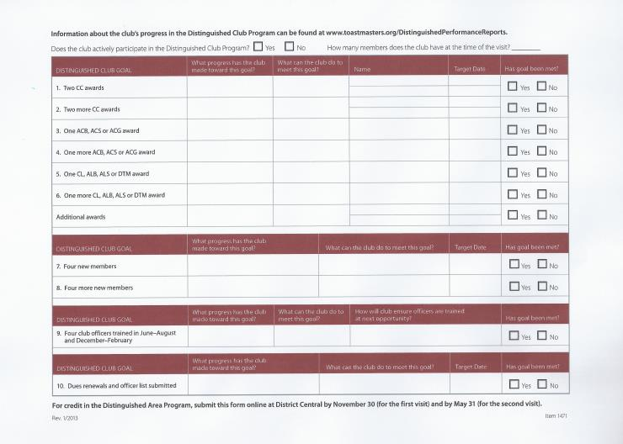
Area Governor Visits & DCP
DISTINGUISHED CLUB GOAL | PROGRESS? | What needs to be done? | Name | Target Date | Has the goal been met?
Two CC awards
Two more CC awards
One ACB, ACS or ACG award
One more ACB, ACS or ACG award
One CL, ALB, ALS or DTM award
One more CL, ALB, ALS or DTM award
DISTINGUISHED CLUB GOAL | PROGRESS? | What needs to be done? | Target Date | Has the goal been met?
7. Four new members
8. Four more new members
DISTINGUISHED CLUB GOAL | PROGRESS? | What needs to be done? | How will club ensure officers are trained? | Has the goal been met?
9. Four club officers trained in June-August and December-February
DISTINGUISHED CLUB GOAL | PROGRESS? | What needs to be done? | Target Date | Has the goal been met?
10. Dues renewals and officer list submitted

Slide 28
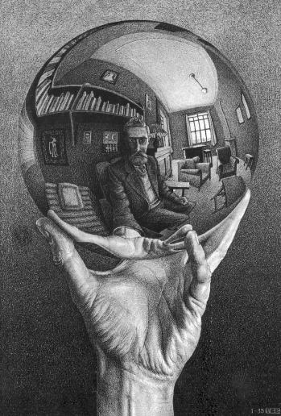
MOT, Area Governor Visits & DCP
Notes:
When the club is functioning the way it should, DCP goals are easily achieved.
DCP is not a tick-the-box exercise, it’s a reflection of how well clubs are serving their members.
Rather than striving for DCP goals, strive for great meetings that are well-organised, friendly and safe places for learning and risk-taking. Everything else will follow automatically.

Slide 29
MOT, Area Governor Visits & DCP
Distinguished
Club
Notes:
When the club is functioning the way it should, DCP goals are easily achieved.
DCP is not a tick-the-box exercise, it’s a reflection of how well clubs are serving their members.
Rather than striving for DCP goals, strive for great meetings that are well-organised, friendly and safe places for learning and risk-taking. Everything else will follow automatically.

Slide 30
Moments of Truth - Member
Established Member
HOW THINGS WORK
Fellowship / Variety / Communication
“I like it here”
“I belong here”
Programme Planning & Meeting Organisation
“We know what we are doing”
“It is worth my while being here”
Membership Strength
“There are enough of us”
Achievement and Recognition
“People notice and celebrate
when I do well”
FIRST IMPRESSIONS - MEMBER ORIENTATION - HOW THINGS WORK

Slide 31
Moments of Truth – Ex Member
“I left for good reasons”
Ex Member
“I left for not so good reasons” and someone takes action to improve things!
“I tell other people about what a great experience it was, and recommend they join”
“I have great memories of a great club”
“I benefitted from being a club member”
FIRST IMPRESSIONS - MEMBER ORIENTATION - HOW THINGS WORK

Slide 32
The Journey of Truth
Curious?
Guest
New Member
Established Member
Ex Member
FIRST IMPRESSIONS - MEMBER ORIENTATION - HOW THINGS WORK

Slide 33
Top 10 Tips for Corporate Clubs
Jean Gamester, DTM

Slide 34
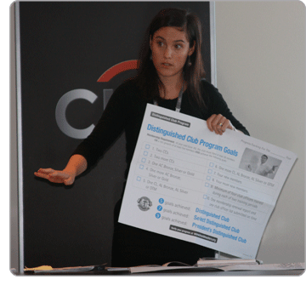
Top 10 Tips for Corporate Clubs
Toastmasters is a leadership development programme, not a social club. Prioritise it that way.
Link Toastmasters goals to personal development plans at work.
Get senior sponsorship and corporate recognition.
Toastmasters is a safe place to experiment with goal setting, tracking and issue resolution
Connect with Toastmasters beyond your club for further development opportunities and building your network.

Slide 35
Top 10 Tips for Corporate Clubs
Exploit your captive audience for PR – intranets, newsletters, noticeboards, handing out flyers at the door, demo meetings.
Aim for 25 to 30 members, with natural turnover of around 5 per year.
Link with induction and training process for newbies, trainees, interns, new managers, promoted people.
Run a Speechcraft course to raise awareness, share your skills. Some will become members.
Run a Youth Leadership Programme to give something back and link in with CSR.

Slide 36
Role Breakouts
Everyone!

Slide 37
Club Officer Roles

Slide 38
TM year Timeline
 | Jul | Aug | Sep | Oct | Nov | Dec | Jan | Feb | Mar | Apr | May | Jun
Club
Area
Div. L
Dist. 91
 | Jul | Aug | Sep | Oct | Nov | Dec | Jan | Feb | Mar | Apr | May | Jun
COT Training (Jul/ Aug)
Pay Dues 30/09
COT Training (Dec / Feb)
Pay Dues 31/03
Club Contest (before Area one)
Club Contest (before Area one)
Renew Officers List - 30/06
Area Contests
Area Contests
AG Club Visits (Aug – Nov)
AG Club Visits (Feb– May)
Division L Contest 02/10
Division L Contest 21/03
Autumn Conference Brighton 31/10 – 02/11
Spring Conference London 8-10/05

Slide 39
Role Breakouts
What are the priorities for your role in your club this year?
What are the opportunities for you in this role in your club?
How can you help your club to be distinguished?

Slide 40
Goals
What are your goals for 2014/15?
What is the one thing you can do to ensure that that goal is met?

Slide 41
Corporate Club Officer Training
District 91 – UK South
July 2014

