Slide 1
Speech Contest
Judges Training
Andy O’Sullivan, DTM, District Chief Judge
Vanessa King, DTM, Program Quality Director
District 91

Slide 2
Agenda
When you’re the judge
Purpose of contests
Obligations of judges
Judging vs evaluating
Characteristics of good judges
Barriers to objectivity
Common misconceptions

Slide 3
Agenda
The art of judging
The judges guide and ballot in detail
will include a break
Discussion topics and case studies
A workshop in contest judging

Slide 4
Three Purposes
Speech contests provide:
An opportunity to practice competitive speaking
Interesting education programs for members and the public
An opportunity to learn by observing proficient speakers

Slide 5
Judges have an obligation to:
Contestants
Toastmasters International
Audience
Themselves

Slide 6
Judging versus Evaluating
Judging = selecting a winner
Evaluating = appraisal and advice
Judges’ decisions are confidential!

Slide 7
Good Judges Are…
Accurate
Fair
Trustworthy
Knowledgeable
Good listeners

Slide 8
Barriers to Objectivity
Speaker position
Champion for the underdog
Halo effect
Reverse halo effect
Second time around
Not the norm
Prejudices and personal preferences

Slide 9
Know the Rules!
Prevent Misconceptions

Slide 10
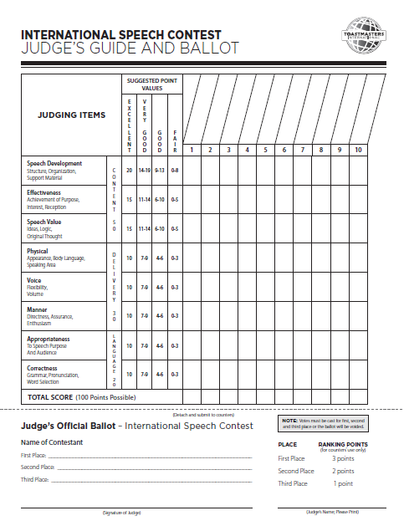
Judge’s Guide and Ballot

Slide 11
The Judge’s Guide
There are many different ways to use the Judges Guide…
Take notes
Use suggested points
Use other point values
Pluses and minuses
…..

Slide 12
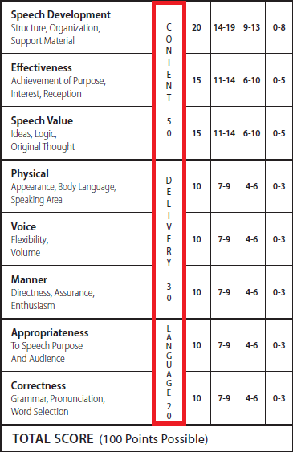
Judging Categories
Content
Delivery
Language

Slide 13
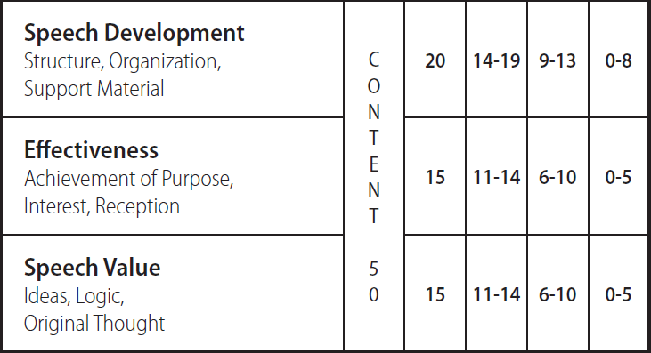
Content
Development
Effectiveness
Value

Slide 14
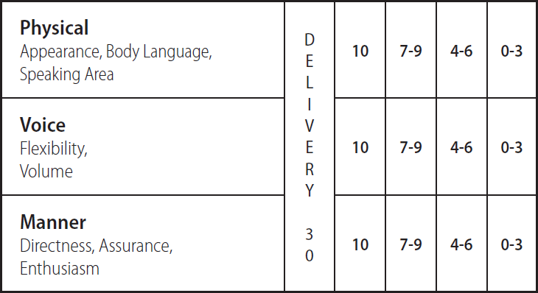
Delivery
Physical
Voice
Manner

Slide 15
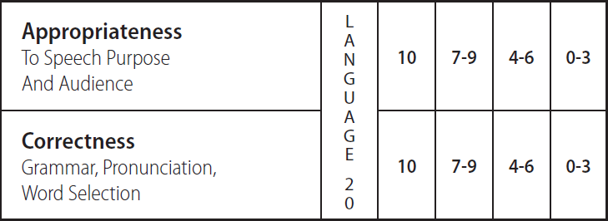
Language
Appropriateness
Correctness

Slide 16
Discussion Topics & Case Studies
What are the reasons for which a contestant may be disqualified?
What happens if one judge leaves the blank for the third-place winner’s name empty on her ballot?
During a contest, what is the procedure for addressing a protest regarding the originality of a speech?

Slide 17
Discussion Topics & Case Studies
What is the appropriate action to take?
A member approaches a contest official and asks to see the points awarded to contestants.
Contest results are announced and the contest meeting is adjourned. After this an individual from the audience complains that judging was unfair.

Slide 18
Discussion Topics & Case Studies
The speech contest rules state that all contestants will speak from the same area designated by the contest chair. If a contestant steps out of the designated speaking area, is he or she disqualified for this rule violation?

Slide 19
Discussion Topics & Case Studies
What happens if:
Four judges sign and print their names on their ballots.
One judge only prints his name on his ballot, but does not sign it.
One judge neither signs nor prints his name on his ballot.
One judge only signs her name on her ballot.

Slide 20
Discussion Topics & Case Studies
Three members compete at an area contest. One contestant is disqualified for speaking overtime. The two announced winners are not able to compete in the division contest. Can the disqualified contestant compete in the division contest?

Slide 21
Discussion Topics & Case Studies
Just before an area International Speech Contest begins, you find out a contestant has completed only five projects in Competent Communication. The contest speech will be his sixth speech.

Slide 22
A Workshop in Contest Judging

Slide 23
Resources
http://d91.toastmasters.org.uk/contests/

