Slide 1
District Executive Committee Meeting
04 December 2021

Slide 2
Housekeeping
Rename yourself as follows:
District Leadership Team
[Role Acronym][Space][Full Name]
Eg: DD Helena Boden-Brewer
Division Directors
[Division][Space][Full Name]
Eg: C Michaela Talbot
Area Directors
[Division][Area Number][Space][Full Name]
Eg: K3 Rose Nakibirango
Assistants
Assistant[Space][Division or Area][Full Name]
Eg: Assistant L John Akers
Extended Team
[Role][Full Name]
DAC Chair Janet Alkema
Please stay muted unless speaking
Refrain from using the chat unless to raise your hand or to raise a motion
Only members of the District Executive Committee are entitled to speak and vote. Members of this committee are the District Leadership Team, Division Directors and Area Directors
If you would like to speak, please raise your hand virtually (or send a chat message) to be recognized, but not while someone else is speaking. Once recognized, please clearly state your name and your role so that our administration manager can record accurate minutes.

Slide 3
Introduction

Slide 4
Agenda

Slide 5
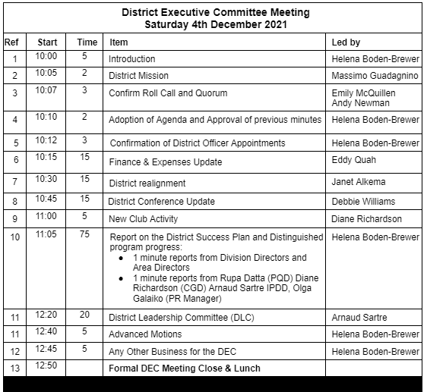
Agenda

Slide 6
District Mission

Slide 7
District Mission
We build new Clubs and support all Clubs in achieving Excellence

Slide 8
Confirm Roll Call and Quorum

Slide 9
Credentials report
52 District Executive Committee (DEC) members
37 Area Directors
8 Divisions
7 District Leadership Team members
A majority of the District Executive Committee constitute a quorum (26)
Registrations: 33
Quorum met

Slide 10
Apologies
Xavier | Graham | Area A Director
Ratan | Lele | Area C2 Director
Rembrandt | Kuipers | Area D14 Director
Colin | Simmons | Area H32 Director
Mike | Weston | Area J4 Director
Pamela | Odukoya | Division K Director

Slide 11
Recommendation to fill District Officer Vacancies

Slide 12
Appointments
Area Directors |  | Appointed
C | 34 | Sabrina | Aici

Slide 13
Finance and Expenses Update

Slide 14
District Alignment

Slide 15
District Conference Update

Slide 16
New Club Activity

Slide 17
Progress Reports

Slide 18
Virtual Coffee Break (10 min)
Back at 11:12

Slide 19
District Leadership Committee

Slide 20
Advanced Motions

Slide 21
Any other business?

Slide 22
Next District Executive Committee Meeting
Saturday 28th February 2022 10am
Meeting Adjourned
Back at 13:50 for the District Leader sessions starting promptly at 14:00
District Officer Training
13:50 |  | Room Open
14:00 | 90 | Conflict Resolution
15:30 | 30 | Break
16:00 | 135 | Division Success Plans - Dragons Den Style Part 2

