Slide 1
District Executive Committee Meeting
26 February 2022

Slide 2
Housekeeping
Rename yourself as follows:
District Leadership Team
[Role Acronym][Space][Full Name]
Eg: DD Helena Boden-Brewer
Division Directors
[Division][Space][Full Name]
Eg: C Michaela Talbot
Area Directors
[Division][Area Number][Space][Full Name]
Eg: K3 Rose Nakibirango
Assistants
Assistant[Space][Division or Area][Full Name]
Eg: Assistant L John Akers
Extended Team
[Role][Full Name]
DAC Chair Janet Alkema
Please stay muted unless speaking
Refrain from using the chat unless to raise your hand or to raise a motion
Only members of the District Executive Committee are entitled to speak and vote. Members of this committee are the District Leadership Team, Division Directors and Area Directors
If you would like to speak, please raise your hand virtually (or send a chat message) to be recognized, but not while someone else is speaking. Once recognized, please clearly state your name and your role so that our administration manager can record accurate minutes.

Slide 3
Introduction

Slide 4
District Mission

Slide 5
District Mission
We build new Clubs and support all Clubs in achieving Excellence

Slide 6
Confirm Roll Call and Quorum

Slide 7
Credentials report
51 District Executive Committee (DEC) members
36 Area Directors
8 Division Directors
7 District Leadership Team members
A majority of the District Executive Committee constitute a quorum (26)
Registrations: 28
Quorum met: Yes

Slide 8
Apologies
35 | H | Moore | Adrian
1 | A | Jones | Benjamin
32 | H | Simmons | Colin
7 | J | Martin-Rendon | Enca
5 | C | Davis | Jeanette
18 | B | Brollo | Joy
22 | J | Rizzo | Mathew
 | PRM | Galaiko | Olga
 | K | Odukoya | Pamela
2 | C | Lele | Ratan
14 | D | Kuipers | Rembrandt
6 | B | Roche | Stephen

Slide 9
Agenda

Slide 10
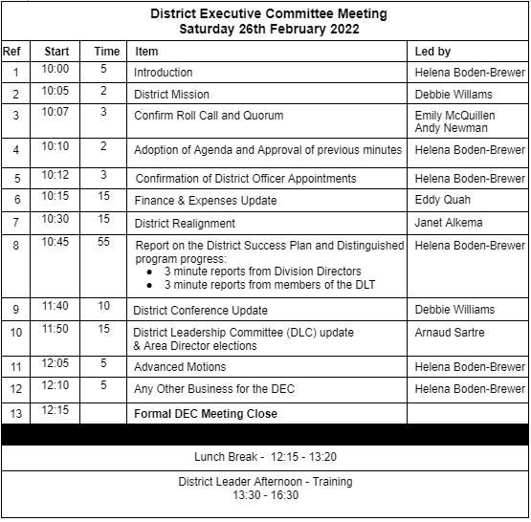
Agenda

Slide 11
Recommendation to fill District Officer Vacancies

Slide 12
Appointments
47 | L | Shah | Sushil
31 | K | Johnson | Almeric

Slide 13
Finance and Expenses Update

Slide 14
District Alignment

Slide 15
Progress Reports

Slide 16
Virtual Coffee Break (10 min)
Back at 11:XX

Slide 17
District Conference Update

Slide 18
District Leadership Committee
& Area Director elections

Slide 19
Advanced Motions

Slide 20
Any other business?

Slide 21
Next District Executive Committee Meeting
Sunday 24th April 2022
In person / Hybrid

