Slide 1
Facilitator Instructions (not for presentation)
Session Overview: This presentation is the last session in Round 2 Mid-Year Club Officer Training –General Session Part 2 (GS2) for all club officers. The Mid-Year Hall of Fame should be shown before the training begins to recognize member and club achievements thus far. General Session Part 1 begins the COT event. After GS1 are the individual club officer breakout sessions. Round 2 Mid-Year COT sessions are designed as a mid-term check-in to assess progress, tackle challenges, and strategize for a successful second half of the year. The training ends with this General Session Part 2 (GS2) for all club officers.
Facilitator Notes: Each slide in GS2 contains detailed facilitator notes to guide your presentation. Review the facilitator notes thoroughly to prepare to train the session. Use the notes as a guide rather than a script that must be stated “word-for-word”. Adapt the language to your personal style.
Timing: The facilitator notes begin with the estimated time to present the individual slide and then the overall elapsed session time. We recommend 45 minutes for this session.
Practice for Proficiency: Please review the facilitator notes and practice delivering this presentation until you feel confident. Your familiarity with the content is key to an effective session.
Action Cues: Parentheses ( ) denote instructions for you, the facilitator, to DO—such as launching a poll, asking a question, or directing participants to a handout.
Notes:
Round 2 Mid-Year Club Officer Training (COT) Planning and Facilitation Team:
A duration of 4 hours is recommended for Club Officer Training (COT). This General Session Part 2 is planned for 45 minutes. The Round 2 Mid-Year training event begins with the Mid-Year Hall of Fame (shown before the training begins), introduction (5 minutes), General Session Part 1 (60 minutes), 10-minute break, club officer breakout sessions (75 minutes), 10-minute break, and finally this General Session Part 2 (45 minutes). The total time allotted for the entire training is 210 minutes or 3 hours 30 minutes with breaks. This schedule leaves a flexible 30-minute slot that can be used for a special presentation on advanced recruitment techniques, a panel discussion addressing the specific membership challenges faced by clubs in your District, Pathways engagement and recognition, or another presentation focused on the needs of the clubs in your District.

Slide 2
Facilitator Instructions (cont’d) (not for presentation)
Interaction: Audience engagement is crucial for a successful training. Use the following methods based on meeting format.
Online: Ask participants to enter their concise responses to questions in the chat. Coordinate with a Chat Master to share a small number of their responses verbally.
Onsite: Ask a few participants to verbalize their responses succinctly in one sentence or less.
Hybrid: Use both methods stated above to engage your in-person and online audiences.
Technical Support (Zoom/Chat Masters): For any online or hybrid training, sufficient District technical support is essential. To facilitate seamless interaction and manage the technical aspects of the session, please ensure at least one dedicated Zoom Master and one Chat Master are assigned to the main room, and as often as possible, assign technical support to each breakout room.
Notes:
Round 2 Mid-Year Club Officer Training (COT) Planning and Facilitation Team:
A duration of 4 hours is recommended for Club Officer Training (COT). This General Session Part 2 is planned for 45 minutes. The Round 2 Mid-Year training event begins with the Mid-Year Hall of Fame (shown before the training begins), introduction (5 minutes), General Session Part 1 (60 minutes), 10-minute break, club officer breakout sessions (75 minutes), 10-minute break, and finally this General Session Part 2 (45 minutes). The total time allotted for the entire training is 210 minutes or 3 hours 30 minutes with breaks. This schedule leaves a flexible 30-minute slot that can be used for a special presentation on advanced recruitment techniques, a panel discussion addressing the specific membership challenges faced by clubs in your District, Pathways engagement and recognition, or another presentation focused on the needs of the clubs in your District.

Slide 3
General Session Part 2
Round 2: Mid-Year Training
Notes:
Time on slide: 1 minute
Elapsed time: 1 minute
Facilitator Notes:
(Say) Welcome to General Session Part 2, the final session of Round 2 Mid-Year Club Officer Training (COT)!

Slide 4

COT Round 2 Mid-Year Agenda
Achieving Continuous Club Success
Root Cause Analysis
Individual Club Officer Breakout Sessions
Member Engagement & Retention
Succession Planning
Wrap-Up
Notes:
Time on slide: 1 minute
Elapsed time: 2 minutes
Facilitator Notes:
(Say) We have covered the first three topics of Round 2 Mid-Year Club Officer Training (COT). This last session, General Session Part 2, will focus on the last three topics, highlighted in yellow:
Membership Engagement & Retention
Succession Planning
Wrap-up

Slide 5

Member Engagement & Retention
Notes:
Time on slide: 1 minute
Elapsed time: 3 minutes
Facilitator Notes:
(Say) Members are at the top of the Toastmasters organizational structure. Clubs do not exist without members. How do we actively engage all our members to fulfill their reasons for joining Toastmasters and for joining your club, specifically? Then, how do we keep them engaged? Lifelong learning is the ongoing process of acquiring new skills, knowledge, and competencies throughout our lives. Toastmasters offers lifelong learning opportunities to our members. We need to promote this to engage and retain our members.

Slide 6

What do you observe in your club?
How many members does your club have?
How many members renewed during the September/October renewal period? How many did not? Why?
What percentage of your members attend meetings regularly? Why?
What are the patterns in member engagement?
Do your members feel that they are receiving value from their membership?
Notes:
Time on slide: 6 minutes
Elapsed time: 9 minutes
Facilitator Notes:
(Ask each question on the slide and emphasize that knowing the answers is very important to them as club officers to evaluate the health of their clubs.)
(Say) The answers to these questions represent data points about the overall health and success of your club, just like the Distinguished Club Program goals. If you do not know the answers to these questions, please research the answers, analyze the root causes, and find the root solutions.
Members in your club: Look at your club’s dashboard for the base membership on June 30 and your current membership.
Membership Renewals in Sep/Oct: Members do not renew for various reasons. Some members leave for professional reasons or because they are moving elsewhere. Some could rejoin your club or another club at a later date. Similarly, some members may have met their goals. Vague reasons or members leaving could indicate challenges with your club or with members feeling unsupported. What are the root causes of members leaving, and what is the root solution for regaining them?
Percentage of members attending meetings: What is the percentage of members attending your club meetings regularly, and why is this the percentage? Members being “busy” is a common response for a low percentage but dig deeper for the root cause. Could it be that members are prioritizing other activities over participating regularly in Toastmasters meetings? If so, does this mean that the club is not providing enough value to them? What is the root cause and what is the root solution for a low percentage of members attending meetings?
Engagement Patterns: Are the same members attending and participating in meetings? Are other members absent again and again? Is there a core group of 10 to 12 members running the club? How can this core group be expanded? What would happen if members of this core group leave? What is the root cause of these patterns, and what is the root solution? What engagement tools are your using with your members – FreeToastHost, EasySpeak, Excel, etc?
Membership Value: Do you know why people are joining your club? Is your club meeting your members’ needs? Does every new member complete a New Member Profile? Are new member mentors meeting regularly with their mentees? Are the new members achieving their reasons for joining your club?

Slide 7

How do you engage your members?
What happens after a guest joins your club?
Who checks-in with individual members to understand their needs?
Is the Treasurer the first person to learn that a member may not renew?
How do you assess why members join and stay?
Notes:
Time on slide: 6 minutes
Elapsed time: 15 minutes
Facilitator Notes:
(Challenge club officers with these questions and gather answers from them. Highlight that these engagement points are crucial during a member’s journey.)
After joining: This is an opportunity for a member to start strong with a member orientation and assignment of a mentor. Club members and the new member’s mentor can encourage the new member to adopt best practices regarding their growth and self-development. Initial interactions also shape the new member’s impressions of the club going forward too. If you club is small and does not have enough members to serve as mentors, have a club officer hold monthly or bi-monthly online mentoring meetings. Invite new and tenured members to attend these mentoring meetings to ask any questions they have about Pathways, meeting roles, and leadership positions.
Check-ins: The VP Education, VP Membership and new member mentors should check-in regularly with the new members to identify what their goals are, to sign them up for meeting roles to achieve their goals, to monitor their progress toward achieving their goals, to provide positive support, and to encourage them to continue to learn and grow in Toastmasters.
Renewals: Regular check-ins should provide advance warnings of who is unlikely to renew their membership, why they will not be renewing, and to address any actionable concerns beforehand.
Assessing why members join and stay: How often do you conduct Moments of Truth to assess your club’s strengths and areas for improvement?

Slide 8

Goal Setting
Do you know your members’ goals and motivations?
Which members need encouragement? Which need a challenge?
What do experienced members need?
Notes:
Time on slide: 4 minutes
Elapsed time: 19 minutes
Facilitator Notes:
(Ask the questions to engage attendees and have them reflect on how their clubs and members are setting goals.)
Emphasize that goals can also involve socialization, building a circle of friends, and getting to know more people. Members join for different reasons.
Particular attention needs to be paid to experienced members, whose presence at meetings and involvement in the Club could be taken for granted. They may be up for a challenge such as delivering longer speeches, facilitating training or organizing an event.
You won’t know what their goals and desires are until you have a conversation with them.

Slide 9

Surveying Your Members
Google Forms are free to use and can be used to gather anonymous feedback
Notes:
Time on slide: 3 minutes
Elapsed time: 22 minutes
Facilitator Notes:
(Say) The best time to survey your members about their experiences in your club is two to three months BEFORE membership renewals. This can be done anonymously via Google Forms.
(Ask) Why is this beneficial? (Example answer: If any members are dissatisfied with your club, this gives you time to address their concerns before renewals are due.)
(Ask) What questions should be included in the survey?
(Then share the ones below.)
(Say) Toastmasters International also provides survey forms for new members and surveys that can be used with the entire club membership.). They can be found at https://www.toastmasters.org/resources/member-interest-survey
Possible survey questions include:
How satisfied are you with your membership? (Rating 1 to 5)
Do you feel your goals are being met?
What do you like about the Club?
What would you like to see the Club doing differently?
How likely are you to continue being a member of the Club?
How often would you like to give speeches?

Slide 10

Succession
Planning
Notes:
Time on slide: 3 minutes
Elapsed time: 25 minutes
Facilitator Notes:
(Say) Succession planning is a process and strategy for replacement planning or passing on leadership roles. It is used to identify and develop new, talented, potential leaders who can move into leadership roles when they become vacant.
Why is succession planning so important? It ensures a seamless transfer of knowledge and expertise from year to year. Leadership transitions are part of growth. Succession planning includes mentoring, rotational opportunities, and shared knowledge. Succession planning ensures stability in leadership, mitigates risk, preserves key knowledge, and enhances morale. It is crucial for continuity and future success.
In Toastmasters, club officers are elected either annually or semiannually. Semiannual elections are only allowed in clubs that meet on a weekly basis. Clubs that meet weekly may then decide whether to elect their club officers for annual or semiannual terms.
(Ask) How is your club planning for succession in leadership roles?
Do you have an Education Committee, a Membership Committee, a PR Committee and an SAA Committee to support your VP Education, VP Membership, VP Public Relations, and Sergeant at Arms? Forming Committees to support elected club officers is a way to develop new club leaders. How is your club grooming/preparing new leaders?

Slide 11

“The greatest contribution of a leader is to make other leaders.”
Simon Sinek
Notes:
Time on slide: 1 minute
Elapsed time: 26 minutes
Facilitator Notes:
(Say) Well known leadership author and keynote speaker, Simon Sinek, knows the value of succession planning as he expresses in his quote here.

Slide 12

If not YOU, then…
WHO?
Notes:
Time on slide: 2 minutes
Elapsed time: 28 minutes
Facilitator Notes:
(Highlight that this is the question that must be openly asked to members in a whole club setting.)
(Say) Your club belongs to its members, and they must step-up to lead it and take ownership of its future.
All members agree to do this when they sign up for membership. The Toastmasters Promise states, “I will serve as a club officer when called upon to do so.” https://ccdn.toastmasters.org/medias/files/department-documents/club-documents/402-a-toastmasters-promise.pdf
Encouraging and asking members who have not served as a club officer to serve as a club officer is something that we, as current club officers, can do to prepare our successor for office. During the club officer induction ceremony (best practice if clubs don't already do it) each club officer commits to being accountable and members commit to support the club officers.

Slide 13
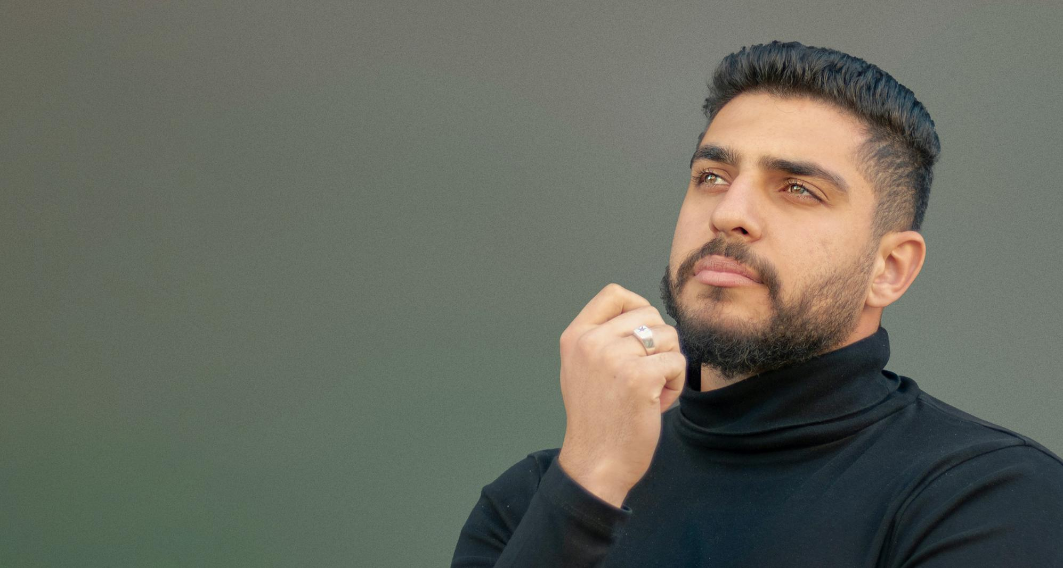
Current Leaders –
What are your plans?
Continue in current role?
Step-up to a new role?
Mentor new leaders!
Notes:
Time on slide: 2 minutes
Elapsed time: 30 minutes
Facilitator Notes:
(Invite leaders present to think about their future plans. Explain that every role EXCEPT for the Club President can be done by the same person for another year.) The goal of a leader is to plan for succession. We should only continue in our current role or a different club officer role if an able successor needs more time to step up to leadership. Maintaining knowledge and experience within the club officer leadership team can be accomplished through mentoring new leaders.
Note: Prepare Your Successor for Office by asking your Committee Member(s) to step up to serving as the next club officer in that role – Education Committee, Membership Committee, PR Committee, and Sergeant at Arms Committee.

Slide 14

Tactics for finding new leaders
Begin succession planning early
Identify active participants in meetings
Who asks questions?
Talk one-on-one about the opportunities and transferable skills from club leadership
Invite members to serve on the Education, Membership, PR, and SAA committees
Notes:
Time on slide: 5 minutes
Elapsed time: 35 minutes
Facilitator Notes:
(Ask) How do you recruit new club leaders? (After the attendees share their ideas, then share the list on this slide and discuss each one.)
Begin succession planning early
Identify active participants in meetings
Who asks questions?
Talk one-on-one about the opportunities and transferable skills offered by club leadership
Invite members to serve on Education, Membership, PR, and SAA committees
(End with…) Talk about succession planning often at Executive Committee meetings and in one-on-one conversations with your club officers. Share the value of club leadership openly with your club's members during club meetings. Discuss the Toastmasters Promise and how it applies to members stepping up to club leadership. It is the sixth step in the Toastmasters Promise.
(For reference: This is A Toastmaster’s Promise:
As a member of Toastmasters International and my club, I promise:
To attend club meetings regularly
To prepare all of my projects to the best of my ability, basing them on the Toastmasters education program
To prepare for and fulfill meeting assignments
To provide fellow members with helpful, constructive evaluations
To help the club maintain the positive, friendly environment necessary for all members to learn and grow
To serve my club as an officer when called upon to do so
To treat my fellow club members and our guests with respect and courtesy
To bring guests to club meetings so they can see the benefits Toastmasters membership offers
To adhere to the guidelines and rules for all Toastmasters education and recognition programs
To act within Toastmasters’ core values of integrity, respect, service and excellence during the conduct of all Toastmasters activities

Slide 15

Transition Best Practices
Election procedure on Pages 49 to 51 of Club Leadership Handbook with 4-week timeline
Create “how to’s” for each role to complement TI documents
Document key tasks, timelines, milestones, processes, and how decisions are made
Notes:
Time on slide: 5 minutes
Elapsed time: 40 minutes
Facilitator Notes:
(Ask) How does your club transition smoothly from your current club officers to new club officers each year? (Gather as many ideas as possible.)
(Say) The hardest part is creating transition documents, if they don’t exist. It is not a best practice to rely on “institutional or tribal” knowledge from year-to-year. Documented transition procedures provide an effective tool for the transition from the current to the new club officers each year for consistent club success.
Suggested transition documents include:
Onboarding Process
List of Mentors and Mentees
Account Access: Financial, Social media, FTH, Website
(Emphasize the importance of documenting everything to ensure smooth club officer transitions from year-to-year. Once documents exist, the transition documents only need to be updated in future years.)

Slide 16

Club Central Officer List Submission
Enter new club officers into Club Central immediately after your May club officer elections
Deadline for all clubs to submit their club officer lists is June 30 to meet DCP Goal 10 for the upcoming year
Weekly clubs with semiannual elections in November receive Goal 10 credit for submission by December 31
Notes:
Time on slide: 2 minutes
Elapsed time: 42 minutes
Facilitator Notes:
(Ask) What are the deadlines for Club Officer Lists submission? Why is this important?
(After receiving their responses, click to show the bullet points. Emphasize the deadline and where this should be done. Any current club officer can update the club officer list of assignments, so there is no excuse for not doing it immediately. Clubs with semiannual elections in November also have a December 31 deadline for submitting a new club officer list and can satisfy Goal 10 on-time club officer list submission for this.)

Slide 17

Wrap-Up
Member Engagement & Retention
Goal Setting
Leadership Succession Planning
Election Protocols
Transition Best Practices
Submitting Updated Club Officer Lists
Notes:
Time on slide: 2 minutes
Elapsed time: 44 minutes
Facilitator Notes:
(Briefly wrap-up by highlighting the key points from the training.)
(Say) Let’s summarize. Round 2 Mid-Year General Session Part 2 Topics included:
Member Engagement & Retention
Goal Setting
Leadership Succession Planning
Election Protocols
Transition Best Practices
Submitting Updated Club Officer List

Slide 18
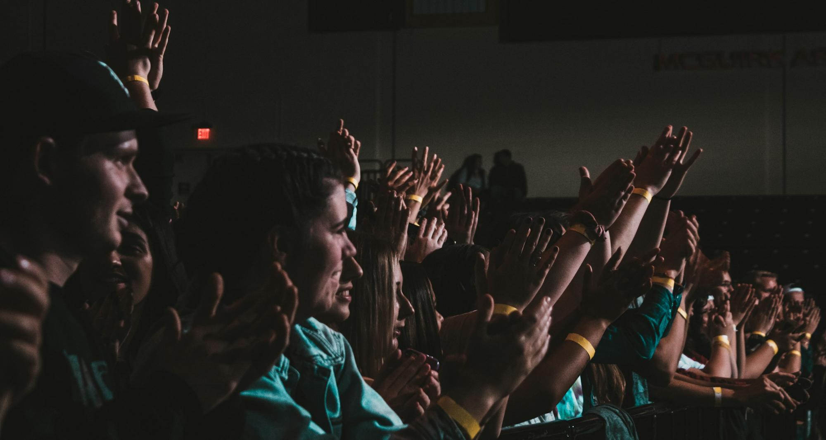
Congratulations!
You have successfully completed
Round 2 Mid-Year Club Officer Training.
Notes:
Time on slide: 1 minute
Elapsed time: 45 minutes
Facilitator Notes:
(Say) Congratulations on fulfilling your second round of club officer training!

