Slide 1
Facilitator Instructions (cont’d) (not for presentation)
Session Overview: This presentation is the Secretary breakout session for the Round 2 Mid-Year Club Officer Training (COT). It is designed as a mid-term check-in to assess progress, tackle challenges, and strategize for a successful second half of the year. It is part of a larger training event that starts with General Session Part 1 for all club officers followed by the individual club officer breakout sessions (like this one) and ends with General Session Part 2 for all club officers.
Facilitator Notes: Each slide contains detailed facilitator notes to guide your presentation. Review the facilitator notes thoroughly to prepare to train the session. Use the notes as a guide rather than a script that must be stated “word-for-word”. Adapt the language to your personal style.
Timing: The facilitator notes begin with the estimated time to present the individual slide and then the overall elapsed session time. We recommend 75 minutes for each individual club officer breakout session, but have included the estimated times for each slide and elapsed session times for a 60-minute session AND a 75-minute session.
Practice for Proficiency: This training includes questions and case studies that MUST be reviewed and practiced for training effectiveness. Please review the facilitator notes and practice delivering the presentation multiple times until you feel confident. Your familiarity with the content is key to an effective session.
Action Cues: Parentheses ( ) denote instructions for you, the facilitator, to DO—such as launching a poll, asking a question, or directing participants to a handout.
Notes:
Round 2 Mid-Year Club Officer Training (COT) Planning and Facilitation Team:
A duration of 4 hours is recommended for Club Officer Training (COT). This club officer breakout session is planned for 75 minutes. The Round 2 Mid-Year training event begins with the Mid-Year Hall of Fame (shown before the training begins), introduction (5 minutes), General Session Part 1 (60 minutes), 10-minute break, club officer breakout sessions (75 minutes), 10-minute break, and finally General Session Part 2 (45 minutes). The total time allotted for the entire training is 210 minutes or 3 hours 30 minutes. This schedule leaves a flexible 30-minute slot that can be used for a special presentation on advanced recruitment techniques, a panel discussion addressing the specific membership challenges faced by clubs in your District, Pathways engagement and recognition, or another presentation focused on the needs of the clubs in your District.

Slide 2
Facilitator Instructions (cont’d) (not for presentation)
Interaction: Audience engagement is crucial for a successful training. Use the following methods based on meeting format.
Online: Ask participants to enter their concise responses to questions in the chat. Coordinate with a Chat Master to share a small number of their responses verbally.
Onsite: Ask a few participants to verbalize their responses succinctly in one sentence or less.
Hybrid: Use both methods stated above to engage your in-person and online audiences.
Technical Support (Zoom/Chat Masters): For any online or hybrid training, sufficient District technical support is essential. To facilitate seamless interaction and manage the technical aspects of the session, please ensure at least one dedicated Zoom Master and one Chat Master are assigned to the main room, and as often as possible, assign technical support to each breakout room.
Customizing the session: This session includes several quiz questions and case studies. Choose the quiz questions and case studies most relevant to your participants and “hide” the slides with questions and case studies you will not use. This session is planned for 75 minutes but you may adapt it to 60 minutes by “hiding” more questions and using only one case study.
Notes:
Round 2 Mid-Year Club Officer Training (COT) Planning and Facilitation Team:
A duration of 4 hours is recommended for Club Officer Training (COT). This club officer breakout session is planned for 75 minutes. The Round 2 Mid-Year training event begins with the Mid-Year Hall of Fame (shown before the training begins), introduction (5 minutes), General Session Part 1 (60 minutes), 10-minute break, club officer breakout sessions (75 minutes), 10-minute break, and finally General Session Part 2 (45 minutes). The total time allotted for the entire training is 210 minutes or 3 hours 30 minutes. This schedule leaves a flexible 30-minute slot that can be used for a special presentation on advanced recruitment techniques, a panel discussion addressing the specific membership challenges faced by clubs in your District, Pathways engagement and recognition, or another presentation focused on the needs of the clubs in your District.

Slide 3
Secretary Training
Round 2: Mid-Year Training
Notes:
Time on slide: 0.5 minute
Elapsed time: 0.5 minutes of 60-minute or 75-minute session
Facilitator Notes:
(Say) Welcome to the Secretary Round 2 Mid-Year Training!

Slide 4

Refresher
Where Are We Now?
Where Are We Going?
Case Studies
Succession Planning
Q&A
Next Steps
Notes:
Time on slide: 1 minute
Elapsed time: 1.5 minutes of 60-minute or 75-minute session
Facilitator Notes:
(Say) Round 2 Mid-Year Club Officer Training focuses heavily on discussion and sharing ideas. Our agenda for the Secretary Round 2 Mid-Year training includes:
Refresher quiz on core responsibilities of the role
Where are we now? Current successes and challenges in your role as Vice President Membership
Where are we going? Where do we want to be by June 30? How will we get there from here?
Case Studies to apply root cause analysis problem-solving techniques
Succession planning
Questions and Answers
Next steps

Slide 5

Secretary Refresher
Notes:
Time on slide: 2 minutes
Elapsed time: 3.5 minutes of 60-minute or 75-minute session
Facilitator Notes:
(Ask) Now that you have served in the Club Secretary role, what are the main responsibilities of the Secretary?
(For online or hybrid training, ask online participants to type concise answers into the Zoom Chat and share a few answers. For onsite audiences, ask those who want to answer to raise their hands and then have a few of them give single phrase or one sentence answers. Limit the discussion to 1.5 minutes.)
(After receiving their responses, you can augment their answers with any of the information below that they did not mention.
Key Responsibilities of a Club Secretary
Plan Executive Committee meetings, prepare the agendas, and record minutes of each meeting
Record minutes of club business meetings
Maintain effective records and administration
Handle club and member communication and correspondence)
(Finish this slide by saying) We covered the Secretary’s responsibilities during Round 1 of Club Officer Training. This was just a refresher.

Slide 6
Club Success Cycle
Guest Interest
Leadership
Research
Vice President Public Relations
Sergeant at Arms
Vice President Membership
Vice President Education
President
Secretary
Treasurer
Advocate - All Members
Engage-ment
Meeting
Advocate
Pathways
Member-ship
Mentoring
Orientation
Notes:
Time on slide: 1.5 minutes
Elapsed time: 5 minutes of 60-minute or 75-minute session
Facilitator Notes:
(Say) We reviewed the Club Success Cycle during Round 1 of Club Officer Training. Where does the Secretary role fit into the Club Success Cycle?
(For online or hybrid training, ask online participants to type concise answers into the Zoom Chat and share a few answers. For onsite audiences, ask those who want to answer to raise their hands and then have a few of them give single phrase or one sentence answers. Limit the discussion to 1 minute.)
(After receiving their responses, you can augment their answers with any of the information below that they did not mention, but limit the time spent on this slide to 1.5 minutes.
Round 1 COT described the Club Secretary’s role in the Club Success Cycle accordingly:
Maintains club’s official documents
Updates club officer and member status in Club Central
Records, distributes, and maintains minutes of Executive Committee and club business meetings
Supports the VPM and VPE in recording new members and Pathways Level completions
Invites guests to meetings and serves on the Meet and Greet Team

Slide 7

Transferable Skills
Meeting coordination
Writing skills (taking minutes, emails)
Time management
Attention to detail
Collaboration
Document management (including archiving)
Communication skills
Notes:
Time on slide: 1.5 minute
Elapsed time: 6 minutes of 60-minute or 75-minute session
Facilitator Notes:
(Say) We all join Toastmasters for our own personal and professional reasons. These are the transferable skills we discussed in Round 1 of Club Officer Training (COT) for the Club Secretary. These are assets you can apply to your career, other volunteer roles, and to your personal life.
(Engage the audience by asking:) Which of these transferable skills have you developed or improved since you began your term as Secretary?
(For online or hybrid training, ask online participants to type concise answers into the Zoom Chat and share a few of their answers. For onsite audiences, ask them to raise their hands as you poll them when calling out each transferable skill.)

Slide 8

Secretary
Refresher Quiz
Notes:
Time for Quiz section: TOTAL of 8 minutes
Elapsed time AFTER Quiz: 14 minutes of 60-minute or 75-minute session
Facilitator Notes:
(The Refresher Quiz: This activity is a quick knowledge check presented in a quiz format.
BEFORE training this session, decide which FOUR or FIVE of the 10 questions you want to ask as a refresher for the Secretaries in attendance.
Hide the five or six slides that you choose not to ask.
For online training, use Zoom polls or a tool, such as Slido, Kahoot, or Mentimeter, if you have access to this type of tool.
For onsite training, read out the questions and ask members to raise their hands to answer. Please spend NO MORE THAN 8 MINUTES on this quiz section.)
(Say) Let’s test your knowledge of the Club Secretary role and responsibilities! The questions are multiple-choice. There may be one or more correct answers per question.

Slide 9

What is the main role of the Club Secretary?
Keep club finances
Record club minutes and maintain club records
Coordinate club meetings
Recruit new members
Order supplies for the club from the Toastmasters store
Notes:
Time for Quiz section: TOTAL of 8 minutes
Elapsed time AFTER Quiz: 14 minutes of 60-minute or 75-minute session
Facilitator Notes:
(Ask the question. For online participants, have them type their answers into the Zoom Chat. For onsite participants, have them raise their hands, if they want to answer.)
(Say) Correct Answer is B.
Briefly explain why the other answers are incorrect:
A. is the responsibility of the Treasurer.
C. is the responsibility of the VPE to coordinate club meetings.
D. is the responsibility of every member, but the VPPR promotes the club to bring in guests to meetings through PR channels, such as social media. The VPM is responsible for organizing Open Houses and Speechcrafts to recruit new members and for encouraging members to invite guests to meetings.
E. is listed in the Club Leadership Handbook as the responsibility of the Secretary, but it is not the main role of the Secretary. Some clubs ask the Treasurer to order supplies. The Sergeant at Arms (SAA) is responsible for maintaining club supplies and notifying the Secretary or Treasurer to order them.

Slide 10

The Secretary may assist with which financial task(s):
Tracking reimbursements
Forwarding membership applications to the Treasurer
Paying club dues directly to TI
Paying expenses to the club’s members
Notes:
Time for Quiz section: TOTAL of 8 minutes
Elapsed time AFTER Quiz: 14 minutes of 60-minute or 75-minute session
Facilitator Notes:
(Ask the question. For online participants, have them type their answers into the Zoom Chat. For onsite participants, have them raise their hands, if they want to answer.)
(Say) Correct Answer is B.
The Club Secretary should forward all membership applications to the Club Treasurer, so they can verify and submit the new member’s fees.
Incorrect Answers
A. This is the role of the Club Treasurer.
C. Again, this is the role of the Club Treasurer.
D. This is once again the role of the Club Treasurer.

Slide 11

Which of these records should the Secretary keep?
Meeting minutes and membership applications
Club banner and gavel
Speech evaluation forms
Contest ballots and judging forms
Club Charter, Club Constitution, Addendum of Standard Options, club processes and procedures, club rosters
Notes:
Time for Quiz section: TOTAL of 8 minutes
Elapsed time AFTER Quiz: 14 minutes of 60-minute or 75-minute session
Facilitator Notes:
(Ask the question. For online participants, have them type their answers into the Zoom Chat. For onsite participants, have them raise their hands, if they want to answer.)
(Say) Correct Answers are:
A. Club Secretary should keep records of both Club and Executive Committee meetings, membership applications, and ensure that the club’s membership records are kept up-to-date.
E. As Club Secretary you should also keep track of the Club Charter, Club Constitution, Addendum of Standard Options, club processes and procedures decided by your club, and your club rosters.
Incorrect Answers:
B. Looking after the club banner and gavel are part of the SAA’s duties
C. Again copies of the speech evaluation forms are the responsibility of the SAA
D. Contest ballot and judging forms are the responsibility of the club’s Chief Judge or the SAA. Many clubs don’t keep spare copies and print them out a little before the contest takes place as there can be minor variations from year to year.

Slide 12

Who receives updated club officer lists from the Secretary?
Club Treasurer
Toastmasters International via Club Central
Club Sergeant at Arms
Area Director
District Director
Notes:
Time for Quiz section: TOTAL of 8 minutes
Elapsed time AFTER Quiz: 14 minutes of 60-minute or 75-minute session
Facilitator Notes:
(Ask the question. For online participants, have them type their answers into the Zoom Chat. For onsite participants, have them raise their hands, if they want to answer.)
(Say) Correct Answer is B.
Any changes to your club officers made during the year should be updated and submitted in Club Central as soon as possible after an election.
The list of new club officers for the new Toastmasters year must be submitted on or before June 30 to ensure that the club receives half of the DCP goal #10 and/or by December 31 for semiannual club elections.
Incorrect Answers:
A and C are club officers, so they can access an online club officers list at any time from Club Central.
D and E – Both the Area and District Directors will receive this information directly from Toastmasters International after you have updated and submitted the list to Toastmasters International.

Slide 13

When must the club officers list be updated?
Every month
After each election or officer change
Once a year in July
Only when asked by District leaders
By June 30 after the May club officer elections
By December 31 after the November semiannual club officer elections
Notes:
Time for Quiz section: TOTAL of 8 minutes
Elapsed time AFTER Quiz: 14 minutes of 60-minute or 75-minute session
Facilitator Notes:
(Ask the question. For online participants, have them type their answers into the Zoom Chat. For onsite participants, have them raise their hands, if they want to answer.)
(Say) Correct Answers are B, E, and F.
The club officers list must be updated as soon as possible after each officer change, which must be confirmed by a club officer election. Next year’s club officers must be posted on Club Central before the end of June to help the club achieve Goal 10 in the DCP program. Clubs with six-month officer terms can still gain a credit for submitting their club officer list by December 31 after semiannual club officer elections in November. Only clubs that meet weekly have the “option” to elect club officers semiannually.
Incorrect Answers:
A. Hopefully the club is not changing club officers every month, so it is not necessary to update the list each month
C. Updating your Club Officer list in July is too late for the club to achieve Goal 10 in the DCP program
D. It is the responsibility of the Secretary to submit the club officer lists timely. District leaders might send a reminder to all clubs to ensure that they have submitted a club officer list on time, but clubs must submit club officer lists by December 31 (for semiannual elections) and by June 30 for ALL clubs.

Slide 14

What is the Secretary’s role with membership applications?
Collect fees from members
Retain and secure signed membership applications
Approve new members
None – this is only the Treasurer’s job
None – it is the VPM’s job to process all new members
Notes:
Time for Quiz section: TOTAL of 8 minutes
Elapsed time AFTER Quiz: 14 minutes of 60-minute or 75-minute session
Facilitator Notes:
(Ask the question. For online participants, have them type their answers into the Zoom Chat. For onsite participants, have them raise their hands, if they want to answer.)
(Say) Correct Answer is B.
Incorrect Answers:
A. This is the responsibility of the Treasurer, who also ensures that the fees owed to Toastmasters International are submitted.
C. The club should vote in all new members during the business part of a club meeting.
D. The Treasurer ensures that the payment is made to Toastmasters, but the Secretary checks that the membership form is signed, as it is a legal document.
E. Usually, the VPM will help an applicant complete the membership application form, but the Secretary checks that the form has been signed.

Slide 15

How does the Secretary support club meetings?
Helps the SAA set up the meeting room
Records meeting attendance, role assignments, and any business actions and motions
Leads Table Topics
Distributes meeting minutes
Serves as General Evaluator
Leads the business meeting portion
Notes:
Time for Quiz section: TOTAL of 8 minutes
Elapsed time AFTER Quiz: 14 minutes of 60-minute or 75-minute session
Facilitator Notes:
(Ask the question. For online participants, have them type their answers into the Zoom Chat. For onsite participants, have them raise their hands, if they want to answer.)
(Say) Correct Answers are B and D.
The Secretary should track member attendance, the meeting roles that members fill to ensure that the roles are recorded for Pathways project completions, and any business actions and motions. In some clubs, the Secretary creates and distributes meeting minutes of club and Executive Committee meetings to club members.
Incorrect Answers:
A. This is the responsibility of the Sergeant at Arms (SAA). The SAA can recruit others or form an SAA Committee to help with meeting room setup.
C. This is the role of the Table Topics Master. The Secretary may serve in any club meeting role.
E. The Secretary may serve as the General Evaluator, but this is not a responsibility of her role as Secretary.
F. Usually the business part of meetings is led by the Club President.

Slide 16

What are the correspondence responsibilities of the Secretary?
Social media postings
Official communication with members, District, and Toastmasters International
Marketing the club
Collecting contest forms
Informing the Area Director of club contest winners
Notes:
Time for Quiz section: TOTAL of 8 minutes
Elapsed time AFTER Quiz: 14 minutes of 60-minute or 75-minute session
Facilitator Notes:
(Ask the question. For online participants, have them type their answers into the Zoom Chat. For onsite participants, have them raise their hands, if they want to answer.)
(Say) Correct Answer is B.
Incorrect Answers:
A. Posting on Social Media is the responsibility of the Club Vice President Public Relations (VPPR).
C. Again, marketing of the club is formally the role of the Club VPPR, but as a club officer you can help the VPPR by advocating for the club and the helping informally to recruit new members and bring guests.
D. Collecting contest forms should be done by the contest Chief Judge.
E. The contest Chief Judge is also responsible for informing the Area Director who has won the club contest or is being put forward as a contestant by the club.

Slide 17

Why is accurate record keeping important?
Makes meetings shorter
Ensures accountability and continuity
Helps create fun agendas
Provides historical records
Creates contest agenda
Notes:
Time for Quiz section: TOTAL of 8 minutes
Elapsed time AFTER Quiz: 14 minutes of 60-minute or 75-minute session
Facilitator Notes:
(Ask the question. For online participants, have them type their answers into the Zoom Chat. For onsite participants, have them raise their hands, if they want to answer.)
(Say) Correct Answers are B and D.
Incorrect Answers:
A, C, and E

Slide 18

How does the Secretary directly support the Distinguished Club Program (DCP)?
Giving more speeches
Promoting contests
Submitting reports and officer lists on time
Attending all Area Council meetings
Submitting the Club Success Plan by September 30
Notes:
Time for Quiz section: TOTAL of 8 minutes
Elapsed time AFTER Quiz: 16 minutes of 60-minute or 75-minute session
Facilitator Notes:
(Ask the question. For online participants, have them type their answers into the Zoom Chat. For onsite participants, have them raise their hands, if they want to answer.)
(Say) Correct Answer are C and E.
Incorrect Answers
A. You should be giving about the same number of speeches, as other club officers and members to ensure that you are making progress with your own Pathway(s) goals. When you finish a level or Path in Pathways, you do directly support the DCP.
B. Contests are not part of the DCP program, so promoting them won’t help your club achieve its DCP goals at the year-end
D. Only Club Presidents, Vice Presidents Education (VPEs), and Vice Presidents Membership (VPMs) are voting members at Area Council meetings.

Slide 19

Where Are We Now?
Notes:
Time on slide: 2 minutes
Elapsed time: 16 minutes of 60-minute or 75-minute session
Facilitator Notes:
(Ask)
Where are we in the Toastmasters year?
How many more months do your members and your club have to achieve the goals in your Club Success Plan?
What goals have your members achieved?
What goals has your club achieved?
What goals have you achieved in your role as Secretary?
Where are we now?
(Note: In this section, it is advisable to write down valuable contributions from attendees to discuss later, time permitting.)
(For online training, invite club officers to enter their responses into the Zoom Chat. Then share some of their responses out loud or ask your Chat Master to do so. If you have a small group and want them to verbalize their responses, ask them to raise their digital hands but limit them to one sentence or less to allow multiple responses.
For onsite training, ask them to raise their hands and again limit them to one sentence or less to have time for multiple responses.)

Slide 20

Successes
Notes:
Time on slide: 2 minutes/3 minutes
Elapsed time: 18 minutes of 60-minute session/19 minutes of 75-minute session
Facilitator Notes:
(Ask) What are your club’s successes? How have you contributed to one or more successes in your club as Secretary?
(For online training, invite club officers to enter their responses into the Zoom Chat. Then share some of their responses out loud or ask your Chat Master to do so. If you have a small group and want them to verbalize their responses, ask them to raise their digital hands but limit them to one sentence or less to allow multiple responses.
For onsite training, ask them to raise their hands and again limit them to one sentence or less to have time for multiple responses.)

Slide 21

Challenges
Notes:
Time on slide: 2 minutes/3 minutes
Elapsed time: 20 minutes of 60-minute session/22 minutes of a 75-minute session
Facilitator Notes:
(Ask)
What are your club’s challenges from your perspective as Club Secretary?
What challenges have you faced as Club Secretary?
If you could improve one aspect of your role as Secretary, what would it be?
What lessons have you learned from anything that has not worked well in your role as Secretary?
Other potential questions to ask, if needed:
What are obstacles to progress?
How would you rate the quality of your club meetings?
How well are members are not progressing in Pathways?
How many new members have joined your club since July 1?
How many members did not renew during the Sep/Oct renewals?
Does the Club Success Plan need to be amended?
Are there any challenges within the Executive Committee?
(For online training, invite club officers to enter their responses into the Zoom Chat. Then share some of their responses out loud or ask your Chat Master to do so. If you have a small group and want them to verbalize their responses, ask them to raise their digital hands but limit them to one sentence or less to allow multiple responses.
For onsite training, ask them to raise their hands and again limit them to one sentence or less to have time for multiple responses.)

Slide 22
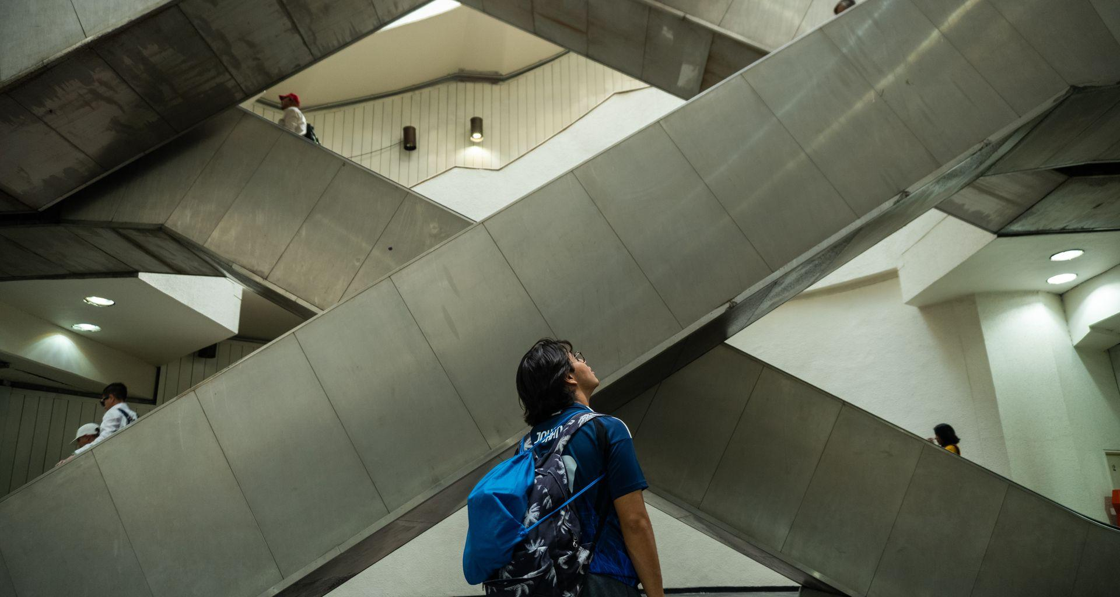
Where Are We Going?
Notes:
Time on slide: 2 minutes/3 minutes
Elapsed time: 22 minutes of 60-minute session/25 minutes of a 75-minute session
Facilitator Notes:
(Say) The end of the Toastmasters year on June 30 is fast approaching. There is still time to resolve any issues identified earlier in this session.
Where is your club going?
How is your club tracking toward the goals in the Distinguished Club Program?
Are your members achieving their individual goals?
What do you need to do as Club Secretary to support your club in achieving its DCP goals by year-end?
(For online training, invite club officers to enter their responses into the Zoom Chat. Then share some of their responses out loud or ask your Chat Master to do so. If you have a small group and want them to verbalize their responses, ask them to raise their digital hands but limit them to one sentence or less to allow multiple responses.
For onsite training, ask them to raise their hands and again limit them to one sentence or less to have time for multiple responses.)
(Share examples, if needed: Meet objectives in the Club Success Plan including DCP goals, member satisfaction, member retention. The Secretary can support the President in reaching out to members about their goals and recognizing their achievements in writing.)

Slide 23

Support for the
Club Success Plan:
Club Secretary’s Checklist
Notes:
Time on slide: 2 minutes/3 minutes
Elapsed time: 24 minutes of 60-minute session/28 minutes of a 75-minute session
Facilitator Notes:
(Ask) How can you, the Secretary, support the Club Success Plan at the beginning of the year, during the year, and at the end of the year?
(For online training, invite club officers to enter their responses into the Zoom Chat. Then share some of their responses out loud or ask your Chat Master to do so. If you have a small group and want them to verbalize their responses, ask them to raise their digital hands but limit them to one sentence or less to allow multiple responses.
For onsite training, ask them to raise their hands and again limit them to one sentence or less to have time for multiple responses.)
(After the sharing from participants, use any additional information provided below. End by saying:) The Secretary’s main role is to keep the actions related to the CSP documented, and shared, ensuring all parties can stay accountable to their goals throughout the year.
(Some answers, if needed, are below.
Beginning of the Year
Submit the Club Success Plan online in Club Central to meet DCP eligibility and for all officers to access when plan updates are needed.
Record CSP planning meeting minutes (goals, deadlines, responsibilities).
Distribute the finalized CSP to all club officers.
File a copy of the CSP in club records for future reference
During the Year
Keep minutes at Executive Committee meetings, noting updates on CSP goals.
Ensure officer and member records in Club Central are up to date (elections, transfers, new members).
Distribute reminders of deadlines (dues, officer training, education awards) as noted in the CSP. Share progress updates from the CSP with officers and members as requested by the President or VPE.
Maintain communication between the club and Area/District leaders when CSP-related reports are requested.
End of the Year
Record final achievements related to CSP goals in club minutes.
Update the CSP to show final progress notes for new officers to access online through Club Central.
File the CSP and related notes in the club records archive for continuity.
Ensure the incoming Secretary and officers receive the CSP and progress notes during officer transitions.)

Slide 24

Root Cause Analysis
Notes:
Time on slide: 0.5 minute
Elapsed time: 24.5 minutes of 60-minute session/28.5 minutes of a 75-minute session
Facilitator Notes:
(Say) We defined Root Cause Analysis (RCA) in General Session Part 1. By using RCA, club officers can clearly define and address the root causes of issues facing their club, not just the symptoms. We will use the 5 Whys problem-solving technique explained in General Session Part 1 to identify the root causes and root solutions for club problems in the following example and in our case studies today. It is important to identify the root cause of a club’s problem. Failure to do so may result in time, effort, and money being spent on the wrong solution. Then the problem remains unsolved because the real root cause of the problem was not identified and only symptoms were treated.

Slide 25
5 Whys Analysis Worksheet
Problem Statement:
The 5 Whys
Why 1
Why 2
Why 3
Why 4
Why 5
Root Causes:
Root Solutions (Corrective Actions):
Notes:
Time on slide: 0.5 minute
Elapsed time: 25 minutes of 60-minute session/29 minutes of a 75-minute session
Facilitator Notes:
(Please distribute the 5 Whys Analysis Worksheet as a pdf in the online chat or as a printed copy for onsite training.)
(Say) The 5 Whys problem-solving technique includes:
Define the problem. Problem Statement:
Ask ‘WHY’ five times to drill down to the root causes.
Write one clear answer for each ‘WHY’
Summarize the root cause(s) identified
Recommend one to two corrective actions, the root solutions

Slide 26

The 5 Whys
Why
Problem statement:
“Secretary Maria does not send out meeting minutes until weeks after the meeting.”
Why
Why
Why
Why
Root Cause
Notes:
Time on slide: 2.5 minutes
Elapsed time: 27 minutes of 60-minute session/31 minutes of a 75-minute session
Facilitator Notes:
(Read the Problem Statement and then work through this example with the participants to find the root cause and root solution(s).)
(Ask) What are “5 Why” questions we should ask to find the root cause of the problem statement on this slide?
(For online training, invite club officers to enter their responses into the Zoom Chat. Then share some of their responses out loud or ask your Chat Master to do so. If you have a small group and want them to verbalize their responses, ask them to raise their digital hands but limit them to one Why statement to allow multiple responses.
For onsite training, ask them to raise their hands and again limit them to one Why statement to have time for multiple responses.)

Slide 27
Example Case Study: 5 Whys Analysis
Why are the minutes sent weeks after the meeting?
  Because Maria postpones finalizing and sending them.
Why does she postpone finalizing and sending them?
  Because preparing minutes feels time‑consuming, and she has other competing priorities.
Why does it feel time‑consuming?
  Because she takes notes on paper and must retype them, without a clear template.
Why doesn’t she use a template or quicker method?
  Because the club hasn’t established a standardized process for taking and distributing minutes.
Why hasn’t the club established a standardized process?
  Because expectations for timeliness and format haven’t been set or reinforced by the Executive Committee.
Notes:
Time on slide: 1 minute
Elapsed time: 28 minutes of 60-minute session/32 minutes of a 75-minute session
Facilitator Notes:
(Show this slide and present this information, only if needed, only if you think that the 5 Whys, Root Cause, and Solution(s) created by the participants is insufficient.)
(If used, say:) This is a possible 5 Whys analysis but not the only one that could be developed.

Slide 28

Root Cause and Root Solutions
List the root cause and one or two root solutions to address the root
cause of the problem.
Notes:
Time on slide: 1 minute
Elapsed time: 29 minutes of 60-minute session/33 minutes of a 75-minute session
Facilitator Notes:
(Ask club secretaries to list the root cause and then 1 to 3 corrective actions that become the root solution(s). Share the examples below, only if needed.)
Root Cause (of the example problem)
The club has no clear expectations or standard process for timely minute production and distribution.
Possible Corrective Actions
Use a digital template for taking meeting minutes
Use a digital note-taking tool, e.g. Zoom AI companion
The Executive Committee needs to set clear expectations and deadlines, e.g. minutes to be distributed within 3 days.
Root Solution (for the example problem)
Establish a 48- to 72-hour delivery standard for Executive Committee meeting minutes, provide a consistent template, and include the process in the club officer handover packet.

Slide 29

Case Studies
Notes:
Time on slide: 1 minute
Elapsed time: 30 minutes of 60-minute session/34 minutes of 75-minute session
Facilitator Notes:
(A total of 6 case studies are available, but facilitators should decide which of these they will use on the day of the training. For a 60-minute training, there will only be time for one or two case studies. For a 75-minute training, there should be time for at least two, maybe three.)
(Say) The goal of the following case studies is to identify the possible root causes and develop root solutions, using the 5 Whys problem-solving root cause analysis technique.

Slide 30
Secretary Case Studies
Missing Venue Agreement
Agenda Reconciliation and Missing Minutes
Missed Officer List Submission Date
The Silent Secretary
The Venue Agreement Challenge
Slow Minutes
Notes:
Time for Case Studies: 20 minutes/30 minutes
Elapsed time AFTER Case Studies: 50 minutes of 60-minute session/64 minutes of 75-minute session
Facilitators Notes:
(Show the list of case studies and either select one or more of the case studies yourself or ask the participants to quickly choose their top three based on the case studies that are relevant to the participants’ “where are we now, successes, challenges, and where are we going” discussions. Then have participants identify the root causes of the club’s problems in the case studies and the root solutions, using the 5 Whys problem-solving technique. Each case study could take 10 to 15 minutes to determine root causes and root solutions.
Note: Each case study is one slide, but the case study slide is followed by a slide with example 5 Whys statements and another slide with a potential root cause and root solution(s). Only use the 5 Whys slide and root cause/root solutions slides, if needed.)

Slide 31
Case Study 1: Missing Venue Agreement
Scenario
Greenfield Communicators Club meets in a rented room at a local business center. A new landlord informs the club that they must vacate the premises immediately.
The Club President recalls that the previous landlord agreement required three months’ notice.
The President asks Marcus, the Secretary, to locate the original agreement. After an extensive search, Marcus reports that he cannot find the document.
What is the Root Cause?
What is/are the Root Solution(s)?
Notes:
Time for Case Studies: 20 minutes/30 minutes
Elapsed time AFTER Case Studies: 50 minutes of 60-minute session/64 minutes of 75-minute session
Facilitator Notes:
(Ask club officers to use the 5 Whys problem-solving technique to create 5 Whys statements, identify the root cause, and determine the root solutions.)

Slide 32
Case Study 1: Missing Venue Agreement
5 Whys Analysis
Why is the club unable to locate the original venue agreement?
  Because the document is not stored in any of the club’s current filing locations.
Why is the document not stored in a current filing location?
  Because the agreement was never added to a central shared repository.
Why was it not added to a central shared repository?
  Because the club does not have a documented process for storing and transferring critical records.
Why does the club not have a documented records management process ?
  Because record-keeping responsibilities are not clearly defined.
Why are record-keeping responsibilities not clearly defined?
  Because the club does not have standardized officer transition and document management processes.
Notes:
Time for Case Studies: 20 minutes/30 minutes
Elapsed time AFTER Case Studies: 50 minutes of 60-minute session/64 minutes of 75-minute session
Facilitator Notes:
(Only show this slide, if needed, after the participants have developed their own 5 Why Analysis, Root Cause, and Root Solutions.)

Slide 33
Case Study 1: Missing Venue Agreement
Root Cause
The club lacks a centralized, documented system for storing and transferring critical administrative documents.
Root Solution
Create a shared, secure document repository (such as a cloud folder or FreeToastHost file area) with clear naming conventions, access for key officers, and a documented handover process.
Notes:
Time for Case Studies: 20 minutes/30 minutes
Elapsed time AFTER Case Studies: 50 minutes of 60-minute session/64 minutes of 75-minute session
Facilitator Notes:
(Only show this slide, if needed, after the participants have developed their own 5 Why Analysis, Root Cause, and Root Solutions.)
Best Practices
Maintain a centralized repository for agreements and key documents.
Use consistent naming and versioning.
Keep digital and backup copies.
Ensure access for relevant officers.
Learning Outcome
Secretaries must ensure critical documents are stored centrally, accessible, and transferred reliably between officer teams.
Continuity Risk
Missing documents break continuity between Executive Committees, force club officers to “start from scratch”, and expose the club to operational and legal risk.

Slide 34
Case Study 2: Agenda Reconciliation and Missing Minutes
Scenario
Meadowbrook Orators meets twice a month. The Club President notices that the agenda on FreeToastHost (FTH) does not match recent club decisions.
Priya, the Secretary, also discovers that minutes from the previous meeting have not been uploaded. Members need those minutes to confirm decisions about an upcoming venue review.
What is the Root Cause?
What is/are the Root Solution(s)?
Notes:
Time for Case Studies: 20 minutes/30 minutes
Elapsed time AFTER Case Studies: 50 minutes of 60-minute session/64 minutes of 75-minute session
Facilitator Notes:
(Ask club officers to use the 5 Whys problem-solving technique to create 5 Whys statements, identify the root cause, and determine the root solutions.)

Slide 35
Case Study 2: Agenda Reconciliation and Missing Minutes
5 Whys Analysis
Why is the agenda incorrect?
  Because agenda updates decided by the club were not transferred into FreeToastHost (FTH).
Why were the updates not transferred?
  Because there is no consistent process for updating and verifying club records.
Why is there no consistent process?
  Because club officers assume others are maintaining FTH without a shared workflow.
Why are responsibilities assumed rather than assigned?
  Because documentation and website maintenance responsibilities are not clearly defined.
Why are responsibilities not clearly defined?
  Because the club does not have a standardized workflow for record management and officer handover.
Notes:
Time for Case Studies: 20 minutes/30 minutes
Elapsed time AFTER Case Studies: 50 minutes of 60-minute session/64 minutes of 75-minute session
Facilitator Notes:
(Only show this slide, if needed, after the participants have developed their own 5 Why Analysis, Root Cause, and Root Solutions.)

Slide 36
Case Study 2: Agenda Reconciliation and Missing Minutes
Root Cause
The club lacks a standardized process for maintaining club records, updating FTH, and transferring responsibilities between officers.
Root Solution
Implement a standardized pre‑meeting checklist for agenda updates and a post‑meeting minutes workflow with deadlines and shared responsibility.
Notes:
Time for Case Studies: 20 minutes/30 minutes
Elapsed time AFTER Case Studies: 50 minutes of 60-minute session/64 minutes of 75-minute session
Facilitator Notes:
(Only show this slide, if needed, after the participants have developed their own 5 Why Analysis, Root Cause, and Root Solutions.)
Best Practices
Compare agendas with club decisions.
Correct inconsistencies before publishing.
Maintain accurate templates.
Upload minutes promptly and consistently.
Learning Outcome
Secretaries ensure the FreeToastHost (FTH) remains a reliable source of truth by maintaining agendas and minutes consistently.
Continuity Risk
Poor documentation continuity leads to repeated mistakes, unclear role ownership, and governance breakdown during officer transitions.

Slide 37
Case Study 3: Missed Officer List Submission Date
Scenario
Silver Oaks Speakers elects new officers in May. The President reminds Helen to submit the Club Officer List before June 30.
The list is not submitted, delaying updates to Toastmasters International records and causing the club to miss its DCP administrative goal.
What is the Root Cause?
What is/are the Root Solution(s)?
Notes:
Time for Case Studies: 20 minutes/30 minutes
Elapsed time AFTER Case Studies: 50 minutes of 60-minute session/64 minutes of 75-minute session
Facilitator Notes:
(Ask club officers to use the 5 Whys problem-solving technique to create 5 Whys statements, identify the root cause, and determine the root solutions.)

Slide 38
Case Study 3: Missed Officer List Submission Date
5 Whys Analysis
Why was the club officer list not submitted?
  Because the Secretary did not complete the submission by the deadline.
Why was the deadline missed?
  Because she did not have a reminder system or workflow for annual submissions.
Why was there no reminder or tracking system?
  Because the club lacks a documented process for tracking mandatory deadlines.
Why does the club lack a documented process?
  Because officer responsibilities were not formally handed over.
Why weren’t responsibilities not formally handed over?
  Because the club did not have a standardized officer transition process.
Notes:
Time for Case Studies: 20 minutes/30 minutes
Elapsed time AFTER Case Studies: 50 minutes of 60-minute session/64 minutes of 75-minute session
Facilitator Notes:
(Only show this slide, if needed, after the participants have developed their own 5 Why Analysis, Root Cause, and Root Solutions.)

Slide 39
Case Study 3: Missed Officer List Submission Date
Root Causes
The Secretary’s responsibility for critical deadlines was not clearly defined or reinforced during club officer training and transition, and systems are not in place to ensure deadlines are met.
The club has no documented compliance calendar or deadline tracking process.
Root Solutions
Set up automatic reminders for important deadlines (club officer list, dues renewals, training deadlines, etc.) for the Secretary and President.
Create a checklist of recurring tasks (e.g., submitting club officer list by June 30) and include this in the Secretary’s handover file.
During Club Officer Training and the first Executive Committee meeting, review key administrative tasks and ensure accountability is clear.
Notes:
Time for Case Studies: 20 minutes/30 minutes
Elapsed time AFTER Case Studies: 50 minutes of 60-minute session/64 minutes of 75-minute session
Facilitator Notes:
(Only show this slide, if needed, after the participants have developed their own 5 Why Analysis, Root Cause, and Root Solutions.)
Best Practices
Maintain a shared deadline calendar.
Submit officer lists promptly.
Document the submission process.
Include compliance tasks in handover packs.
Learning Outcome
Administrative deadlines must be tracked, documented, and completed promptly to support club recognition and governance.

Slide 40
Case Study 4: The Silent Secretary
Scenario
Anita, the Secretary, attends Executive Committee meetings and diligently takes notes. She is very quiet and does not speak up or ask clarifying questions when she is unclear.
Executive Committee officers often complain that the minutes do not always accurately reflect the decisions made and actions agreed.
What is the Root Cause?
What is/are the Root Solution(s)?
Notes:
Time for Case Studies: 20 minutes/30 minutes
Elapsed time AFTER Case Studies: 50 minutes of 60-minute session/64 minutes of 75-minute session
Facilitator Notes:
(Ask club officers to use the 5 Whys problem-solving technique to create 5 Whys statements, identify the root cause, and determine the root solutions.)

Slide 41
Case Study 4: The Silent Secretary
5 Whys Analysis
Why are minutes inaccurate?
  Because some meeting discussions and decisions were not accurately captured.
Why were they not accurately captured?
  Because the Secretary did not seek clarification when information was unclear.
Why did the Secretary not seek clarification?
  Because expectations for actively confirming information were not communicated.
Why were those expectations not communicated?
  Because there is no documented standard for preparing and reviewing meeting minutes.
Why is there no documented standard?
  Because the club does not have a standardized process for Secretary turnover and records management.
Notes:
Time for Case Studies: 20 minutes/30 minutes
Elapsed time AFTER Case Studies: 50 minutes of 60-minute session/64 minutes of 75-minute session
Facilitator Notes:
(Only show this slide, if needed, after the participants have developed their own 5 Why Analysis, Root Cause, and Root Solutions.)

Slide 42
Case Study 4: The Silent Secretary
Root Cause
Because the club lacks a standardized process for Secretary tasks for minute-taking, record management, and officer transition
Root Solutions
During Executive Committee orientation, make it clear that the Secretary is responsible for ensuring minutes are accurate and should ask clarifying questions when needed.
Use a template or Excel with sections for decisions, action items, and owners, so that accuracy is built into the structure.
The President should encourage the Secretary to speak up during meetings and confirm action items by reading them aloud at the end of each meeting.
Notes:
Time for Case Studies: 20 minutes/30 minutes
Elapsed time AFTER Case Studies: 50 minutes of 60-minute session/64 minutes of 75-minute session
Facilitator Notes:
(Only show this slide, if needed, after the participants have developed their own 5 Why Analysis, Root Cause, and Root Solutions.)
Best Practices
Ask clarifying questions.
Summarize decisions aloud.
Use a consistent structure.
Share draft minutes promptly.
Learning Outcome
Secretaries must actively participate to ensure accurate documentation.

Slide 43
Case Study 5: The Venue Agreement Challenge
Scenario
The Phoenix Club meets in a local library twice per month. The venue requires a new signed agreement each year.
The library emails the updated paperwork to the Club President who then forwards it to Priya, the Secretary, asking her to handle it.
Priya isn’t sure if it’s her role or that of the SAA and does not act promptly.
A week later, the club is told they have lost their reservation for the meeting room.
What is the Root Cause?
What is/are the Root Solution(s)?
Notes:
Time for Case Studies: 20 minutes/30 minutes
Elapsed time AFTER Case Studies: 50 minutes of 60-minute session/64 minutes of 75-minute session
Facilitator Notes:
(Ask club officers to use the 5 Whys problem-solving technique to create 5 Whys statements, identify the root cause, and determine the root solutions.)

Slide 44
Case Study 5: Venue Agreement Challenge
5 Whys Analysis
Why was the venue agreement not returned on time?
  Because the Secretary did not take action after receiving the agreement.
Why did the Secretary not take action?
  Because she was unsure if the agreement was her responsibility or the SAA’s.
Why was the Secretary unsure about the responsibility?
  Because venue responsibilities for venue agreements were not clearly documented.
Why was the responsibility not clearly assigned?
  Because the club does not have documented processes for venue administration and renewals.
Why hasn’t the club established a documented process for venue administration?
  Because venue administration is not included in club officer handover responsibilities.
Notes:
Time for Case Studies: 20 minutes/30 minutes
Elapsed time AFTER Case Studies: 50 minutes of 60-minute session/64 minutes of 75-minute session
Facilitator Notes:
(Only show this slide, if needed, after the participants have developed their own 5 Why Analysis, Root Cause, and Root Solutions.)

Slide 45
Case Study 5: Venue Agreement Challenge
Root Cause
The vital venue responsibilities of the Secretary role were not clearly defined during handover, leading to losing their meeting room reservation.
Root Solutions
Create a written checklist of recurring annual tasks (e.g., venue agreements, officer submissions, dues renewals).
Assign clear ownership to specific officers (e.g., Secretary handles venue agreements).
During the first Executive Committee meeting, review the checklist together. Ensure every officer understands their specific responsibilities, including who manages external paperwork.
Enter key deadlines (venue agreement, dues deadlines, contests, TI reports) into a shared calendar (Google Calendar, Outlook). Set automatic reminders for responsible officers at least 2 weeks before deadlines.
The Club President should also follow-up with the Secretary on important tasks.
Notes:
Time for Case Studies: 20 minutes/30 minutes
Elapsed time AFTER Case Studies: 50 minutes of 60-minute session/64 minutes of 75-minute session
Facilitator Notes:
(Only show this slide, if needed, after the participants have developed their own 5 Why Analysis, Root Cause, and Root Solutions.)
Best Practices
Confirm responsibilities early.
Document the venue‑renewal process.
Add deadlines to the club calendar.
Maintain a venue file.
Learning Outcome
Clear role definition prevents delays and protects the club’s meeting space.

Slide 46
Case Study 6: Slow Minutes
Scenario
Maria takes diligent notes but distributes minutes weeks after meetings, causing forgotten decisions and missed actions.
What is the Root Cause?
What is/are the Root Solution(s)?
Notes:
Time for Case Studies: 20 minutes/30 minutes
Elapsed time AFTER Case Studies: 50 minutes of 60-minute session/64 minutes of 75-minute session
Facilitator Notes:
(Ask club officers to use the 5 Whys problem-solving technique to create 5 Whys statements, identify the root cause, and determine the root solutions.)

Slide 47
Case Study 6: Slow Minutes
5 Whys Analysis
Why are the meeting minutes distributed late?
  Because the Secretary does not prepare and distribute them promptly after meetings.
Why are the minutes not prepared and distributed promptly?
  Because there is no defined workflow or deadline.
Why is there no defined workflow or deadline?
  Because the club has not established expectations for timely distribution of meeting minutes.
Why has the club not established those expectations?
  Because administrative procedures and timelines are not formally documented.
Why are administrative procedures and timelines not formally documented?
  Because the club does not have a standardized process for records management.
Notes:
Time for Case Studies: 20 minutes/30 minutes
Elapsed time AFTER Case Studies: 50 minutes of 60-minute session/64 minutes of 75-minute session
Facilitator Notes:
(Only show this slide, if needed, after the participants have developed their own 5 Why Analysis, Root Cause, and Root Solutions.)

Slide 48
Case Study 6: Slow Minutes
Root Cause
The club lacks clear expectations and timelines for meeting minutes distribution.
Root Solution
Establish a 48- to 72-hour meeting minutes‑delivery standard and include it in the club officer handover packet.
Notes:
Time for Case Studies: 20 minutes/30 minutes
Elapsed time AFTER Case Studies: 50 minutes of 60-minute session/64 minutes of 75-minute session
Facilitator Notes:
(Only show this slide, if needed, after the participants have developed their own 5 Why Analysis, Root Cause, and Root Solutions.)
Best Practices
Draft minutes within 48–72 hours.
Use a consistent template.
Set personal deadlines.
Maintain a minutes archive.
Learning Outcome
Timely minutes support accountability, clarity, and effective governance.

Slide 49
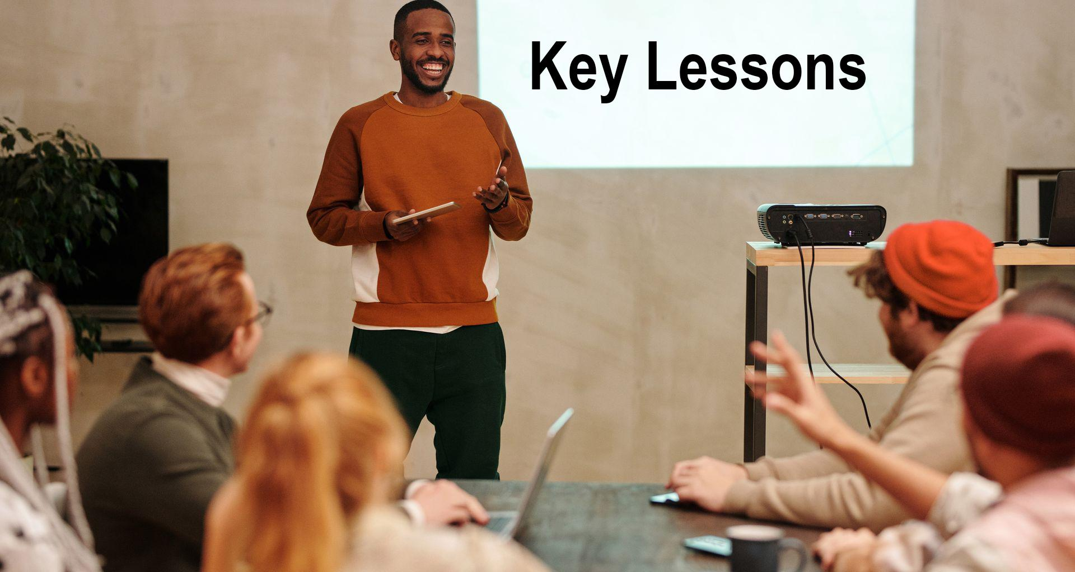
Notes:
Time on slide: 1 minute/2 minutes
Elapsed time: 51 of 60-minute session/66 minutes of 75-minute session
Facilitator Notes:
(Interactive Activity – Ask participants:) What key lessons have you learned during your time as Secretary and from the training today?
(For online training, invite club officers to enter their responses into the Zoom Chat. Then share some of their responses out loud or ask your Chat Master to do so. If you have a small group and want them to verbalize their responses, ask them to raise their digital hands but limit them to one sentence or less to allow multiple responses.
For onsite training, ask them to raise their hands and again limit them to one sentence or less to have time for multiple responses.)
Examples of Answers, if needed:
Use of Zoom AI Assistant and minutes-taking Apps to speed up minutes-taking
Accurate records, such as minutes and membership lists keep the club running smoothly
A consistent approach, such as use of templates and checklists
The role isn’t just about paperwork; it’s also about ensuring everyone receives the necessary updates.

Slide 50

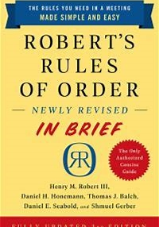
Effective Minute-Taking
Teams & Zoom meeting have features that support meeting minute creation
Google Meet does transcripts which can be converted into minutes
Otter.ai and other specialist tools can also be used
Chapter 16, pp 144-154
Notes:
Time on slide: 1 minute
Elapsed time: 52 of 60-minute session/67minutes of 75-minute session
Facilitator Notes:
(Say) To support effective minute‑taking, several tools can help you capture what happens in a meeting. Microsoft Teams and Zoom both include built‑in transcription features that make creating minutes easier. Google Meet also provides transcripts that you can convert into minutes afterwards. If you prefer specialist tools, applications like Otter.ai can generate detailed notes automatically.
And if you don’t have access to any of these tools, Robert’s Rules of Order (Chapter 16) gives clear guidance on how to take minutes manually.
(Share the link to the Toastmasters meeting minutes template with attendees:
Club EXCOM Meeting Minutes Templates
(https://www.toastmasters.org/resources/club-executive-meeting-minutes)
Club Meeting Minutes Templates
(https://www.toastmasters.org/resources/club-meeting-minutes)

Slide 51
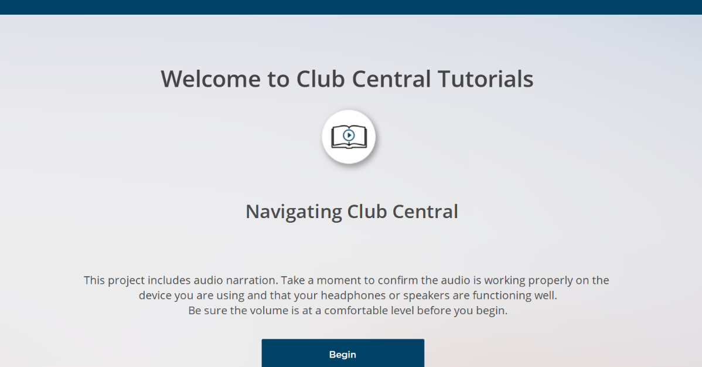

Portal Navigation Video
Notes:
Time on slide: 1 minute
Elapsed time: 53 of 60-minute session/68 minutes of 75-minute session
Facilitator Notes:
(Say) To help club officers navigate Club Central, a video is available on the Toastmasters.org website.

Slide 52
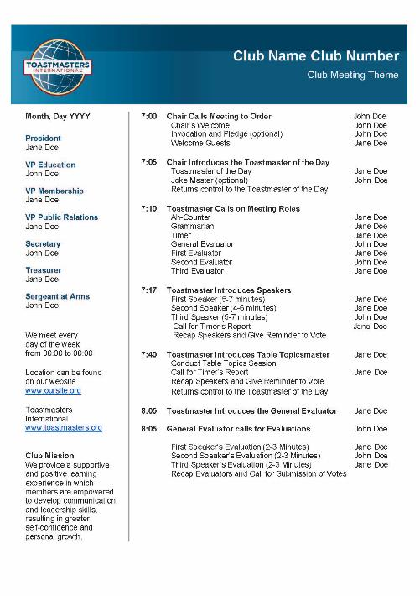
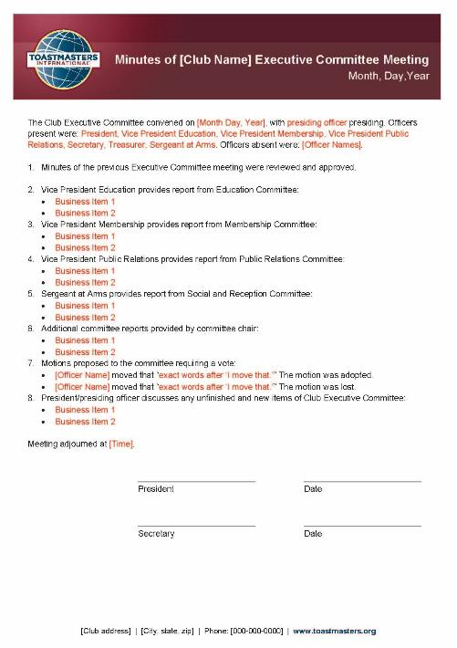
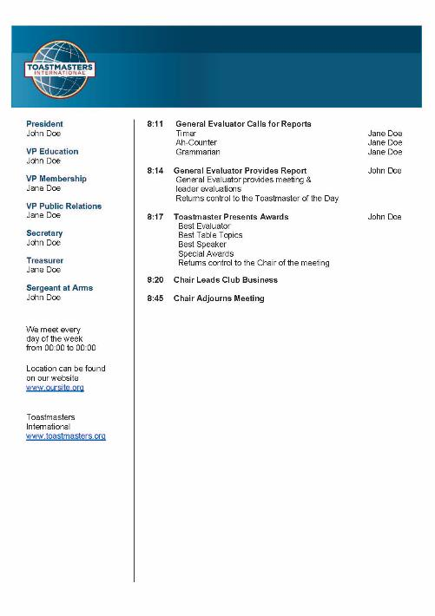


Secretary Template Kit
Notes:
Time on slide: 1 minute
Elapsed time: 54 of 60-minute session/69 minutes of 75-minute session
Facilitator Notes:
(Say) To support Club Secretaries, Toastmasters created a series of Microsoft Word Templates to help write Executive Committee meeting minutes and club meeting agendas, if the meeting management club software you use does not generate its own formatted minutes or agenda for you.
(Share in the Zoom chat for online or hybrid trainings)
ExCom meeting template: https://www.toastmasters.org/resources/club-executive-meeting-minutes
Club meeting minutes template: https://www.toastmasters.org/resources/club-meeting-minutes

Slide 53

Succession Planning
Start early to search for a successor - appoint an assistant, organize role shadowing
Agree on dates for transition sessions
Provide a structured transition with a plan and checklist
Notes:
Time on slide: 2 minutes
Elapsed time: 56 of 60-minute session/71 minutes of 75-minute session
Facilitator Notes:
(Say) Succession planning and a timely transition are essential in Toastmasters officer roles.
(Ask) How were you selected to serve as Secretary this year? Which member of your club do you want to serve as Secretary next year? What skills does this member have to serve as the Secretary next year?
(For online training, invite club officers to enter their responses into the Zoom Chat. Then share some of their responses out loud or ask your Chat Master to do so. If you have a small group and want them to verbalize their responses, ask them to raise their digital hands but limit them to one sentence or less to allow multiple responses.
For onsite training, ask them to raise their hands and again limit them to one sentence or less to have time for multiple responses.)
(Use the information below to add to the responses from the officers. Show the points on the slide.
The Top 3 Transition Tips are:
Start early to search for a successor – appoint an assistant, organize role shadowing.
Agree on dates for transition sessions
Provide a structured handover with a plan and checklist
For the new Secretary, a good transition isn’t just about handing over documents - it’s about ensuring your successor feels confident, supported, and ready to keep the club’s information flowing smoothly.
Here are some ways the Secretary can prepare for the transition to the incoming Secretary:
Create a Secretary Transition Handover Information Packet that includes the following:
Club and Executive Committee meeting minutes for at least the past 12 months
Club Central login steps
Officer contact list for the current and incoming officers
Current member list (in Club Central) and previous club member lists
Templates for the club and Executive Committee agendas, minutes, and email reminders
Key deadlines for Club Success Plan, officer lists, first and second round club officer training, and membership renewals
Accounts and password access (if maintained by the Secretary)
Document “How To” Processes
Provide step-by-step notes for:
Entering club officer changes in Club Central
Submitting Distinguished Club Program (DCP) related updates
Distributing meeting minutes
Mentor the Incoming Secretary
Invite successor to at least one Executive Committee meeting where the successor observes and helps prepare minutes
Walk them through how to make updates in Club Central
Answer questions and share tips on planning, organizing, and managing time and communication

Slide 54

Questions & Answers
Notes:
Time on slide: 1.5 minutes
Elapsed time: 57.5 of 60-minute session/72.5 of 75-minute session
Facilitator Notes:
(Answer any questions from the club secretaries.)

Slide 55

Next Steps
Continue to keep accurate records
Support membership dues renewal (March cycle)
Monitor Club Success Plan progress
Start recruiting your successor
Prepare for election and transition
Submit new club officer list by June 30 for all clubs and by December 31 for semiannual elections
Ensure transition continuity and communication
Notes:
Time on slide: 2 minutes
Elapsed time: 59.5 of 60-minute session/74.5 of 75-minute session
Facilitator Notes:
(Say) The final six months should be focused on helping your club finish the year strong and start the new year smoothly. What are the key actions a Club Secretary needs to complete between January and June?
(For online training, invite club officers to enter their responses into the Zoom Chat. Then share some of their responses out loud or ask your Chat Master to do so. If you have a small group and want them to verbalize their responses, ask them to raise their digital hands but limit them to one sentence or less to allow multiple responses.
For onsite training, ask them to raise their hands and again limit them to one sentence or less to have time for multiple responses.)
(Use the information below to add to the responses from the officers. Show the “Next Steps” on the slide.
Note that the role of Secretary varies depending on the club, e.g. in some clubs the Secretary supports the Treasurer in monitoring dues. In others, they work more closely with the VPPR and update the website. Invite officers to share what happens in their club.
1. Continue to keep accurate records
Maintain detailed meeting minutes and Executive Committee records.
Update officer and member records in Club Central promptly.
Verify the membership roster is correct in Club Central.
2. Support membership dues renewal (March cycle)
Coordinate with the Treasurer to ensure all renewals are processed on time.
Track payments and confirm status in Club Central to avoid lapses in membership.
3. Monitor Club Success Plan progress
Record updates for the Distinguished Club Program (DCP) progress in minutes.
Share reminders with officers about key deadlines and reporting.
Document achievements contributing to year-end recognition.
4. Start recruiting your successor
Observe your club members – Who would be a good replacement for you?
Approach these members and explain the responsibilities of the Secretary’s role
Ask about their interest in serving as a club officer
Share their interest with the Executive Committee and the Club Leadership Chair, who is seeking club officer candidates
5. Prepare for Elections and Transition
Support officer elections (April–June) and accurately record results.
Submit the Incoming Officer List in Club Central by June 30.
Organize and archive all club records for smooth transition to the new Secretary.
6. Submit new club officer list by June 30*
After club elections, submit new club officer list in Club Central by June 30 *or for clubs with semi- annual elections in November, submit by December 31.
7. Ensure Transition Continuity and Communication
Respond promptly to correspondence from Area/District leaders.
Distribute minutes, officer updates, and reminders to members.
Preserve a clear archive of club documents for the incoming leadership team.
Additional information, if needed:
By December 31: Confirm and update the club officer list in Club Central (if your club elects new officers at mid-year).
January: Check renewal dates for meeting venue, if applicable.
February: Ensure the club roster in Club Central is accurate. Confirm member eligibility lists with Treasurer and VPE, as this is important for contests.
March: File minutes of any special meetings, e.g. contest planning.
April: Begin preparing administrative materials for club officer elections (scheduled in May).
May: After club officer elections, submit the new club officer list in Club Central by June 30 or for clubs with semiannual elections in November, submit by December 31.
June: Transition – Organize handover with incoming Secretary. Confirm that all administrative tasks for the year are complete, including club officer list and venue agreements.

Slide 56
Thank You for Serving as Club Secretary
Notes:
Time on slide: 0.5 minutes
Elapsed time: 60 of 60-minute session/75 of 75-minute session
Facilitator Notes:
(Say) Thank you for serving your club as Secretary and for participating in this training!

